Slide 1

Stats for Rats
Statistical Considerations in Basic Science Research
Courtney McCracken, M.S., PhD(c)
Traci Leong, PhD
May 1st, 2012

Slide 2
Overview
Biostatistics Core
Basic principles of experimental design
Sample size and power considerations
Data management

Slide 3

Biostatistics Core
How to involve a biostatistician
  Go to:
    http://www.pedsresearch.org/cores/detail/biostats
    Fill out a request form under “How to Access”

Slide 4
Biostatistics Core
We provide an initial 1 hour session for any requested assistance. During this session, the scope of the request and needed resources are determined. The maximum number of fully subsidized hours per service is as follows:
Grant Applications
*Analysis for internal seed funds and pilot projects: 8 hours
*Subsequent work on an intramurally funded project: 8 hours
*Career Development Award applications: 12 hours
*Analysis for mid-level projects, such as R21s, R01s and Foundation Grants: 16 hours
Manuscripts & Abstracts/Poster Presentations
* Analysis towards manuscripts/ abstracts/posters to serve as foundation of grant application:
8 hours
* Analysis towards manuscripts/ abstracts/posters that are not leading towards grant applications:
4 hours/investigator with a maximum of two times per year

Slide 5
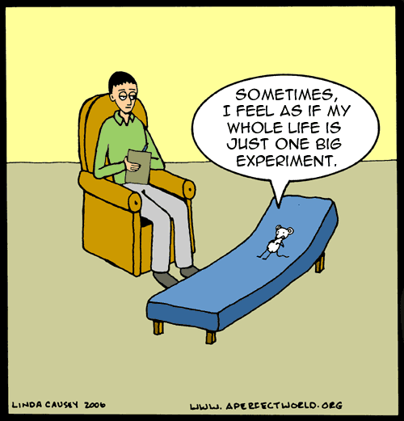
Basic principles of Experimental Design
5

Slide 6
Basic principles of Experimental Design
Formulate study question/objectives in advance
Determine treatment and control groups or gold standard
Replication
Randomization
Stratification (aka blocking)
Factorial experiments
6

Slide 7
Formulate study question/objectives in advance
Make sure your research questions are:
  Clear
  Achievable
  Relevant
You have clearly defined:
  Response variable(s)
  Treatment/control groups
Identified potential sources of variability

Slide 8
Formulate study question/objectives in advance
Multiple Response Variables
Many trials/experiments measure several outcomes
Must force investigator to rank them for importance
  Do sample size on a few outcomes (2-3)
  If estimates agree, OK…if not, must seek compromise

Slide 9
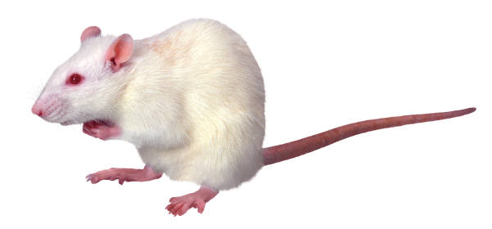
Example
Question: Does salted drinking water affect blood pressure (BP) in rats?
Experiment:
  Provide a mouse with water containing 1% NaCl.
  Wait 14 days.
  Measure BP.
9

Slide 10
Comparison/control
Good experiments are comparative.
  Compare BP in rats fed salt water to BP in rats fed plain water.
  Compare BP in strain A rats fed salt water to BP in strain B rats fed salt water.
  Note: parallel controls are preferable over historical controls
    Reduces variability
10

Slide 11
Replication
Performing same experiment under identical conditions
Crucial in laboratory experiments
  Reduce the effect of uncontrolled variation
  Quantify uncertainty
  To assure that results are reliable and valid
Replication can also introduce new sources of variability

Slide 12
Example
  15 rats were randomized to receive water containing 1% NaCl and 15 rats were randomized to receive water.
    10 days later a new batch of 30 rats were ordered and the same experiment was performed.
96 well plates contain tissues samples from genetically identical rats. A solution is added to each of the well plates

Slide 13
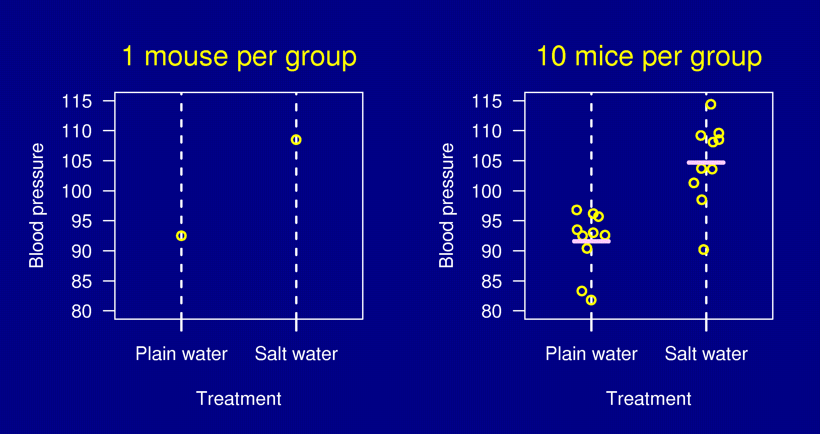
Replication
13

Slide 14
Replication
Try to keep replicates balanced
  i.e., perform the same number of replicates per group/cluster
    For balanced designs, we can average replicates within a group/cluster together and compare group/cluster means
Try to perform replication under the same day (if possible) to reduce any unexplainable variability due to day to day differences in experiments.

Slide 15
Replication
Ex. N=20 mice (10 per trt. group)
  Each mouse performs same experiment 4 times (e.g., 4 replicates). 4 x 20 = 80 observations (40 per group)
  You do NOT have 80 independent observations.
    You have 20 independent samples and within each sample you have 4 correlated observations.
  Ignoring the correlation within observations can bias results.
  2 options:
    Average across 4 observations within subject and analyze means from each rat.
      Only works for balanced designs
    Take into account the correlation between observations by incorporating into statistical procedures.

Slide 16
Randomization
Experimental subjects (“units”) should be assigned to treatment groups at random.
At random does not mean haphazardly.
One needs to explicitly randomize using
  A computer, or
  Coins, dice or cards.
16

Slide 17
Importance of Randomization
Avoid bias.
  For example: the first six rats you grab may have intrinsically higher BP.
Control the role of chance.
  Randomization allows the later use of probability theory, and so gives a solid foundation for statistical analysis.
17

Slide 18
Stratification
Suppose that some BP measurements will be made in the morning and some in the afternoon.
If you anticipate a difference between morning and afternoon measurements:
  Ensure that within each period, there are equal numbers of subjects in each treatment group.
  Take account of the difference between periods in your analysis.
This is sometimes called “blocking”.
18

Slide 19
Basic Statistics for Stratification
Categorical
  Cochran Mantel-Haenszel Test
    Each strata has its own AxB contingency table
    Does the association between A and B, in each table, change as you move across each level of the strata
      Yes, then differences exists between strata
      No, no need for stratification and can collapse across strata
 | Wild + | Wild -
D+ | 5 | 10
D- | 7 | 2
 | Wild + | Wild -
D+ | 20 | 0
D- | 1 | 5
Males
Females

Slide 20
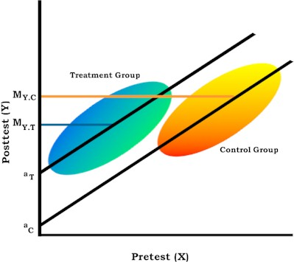
Basic Statistics for Stratification
Continuous
  Analysis of Covariance (ANCOVA)
    Make a separate linear model for each level of the strata
    Compare and contrast slopes and y-intercepts
    Caution: Must check assumptions
  Analysis of Variance (ANOVA)
    Factorial experiments
    (see later slides)

Slide 21
Example
20 male rats and 20 female rats.
Half to be treated; the other half left untreated.
Can only work with 4 rats per day.
Question? How to assign individuals to treatment
groups and to days?
21

Slide 22
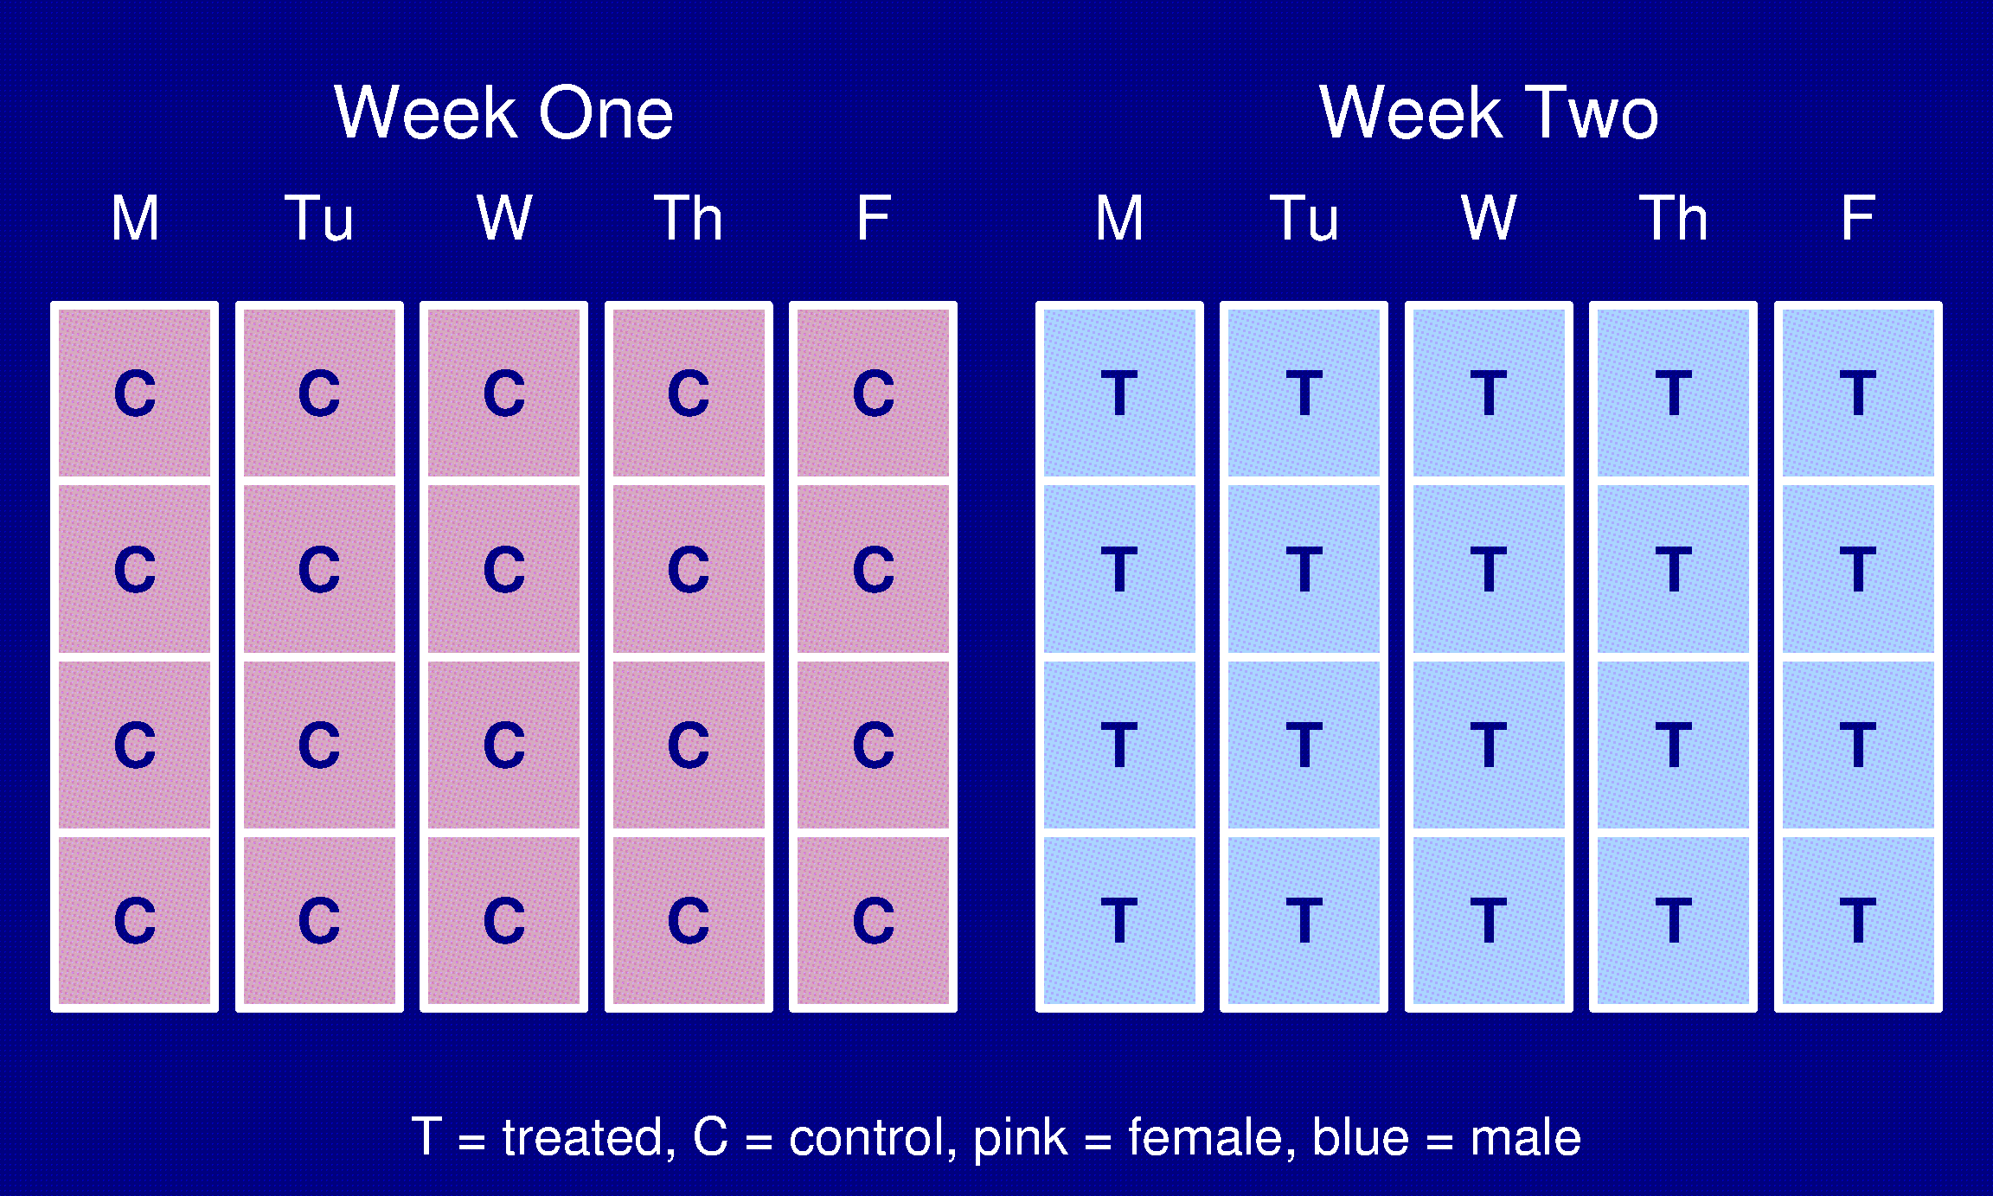
An extremely bad design
22

Slide 23
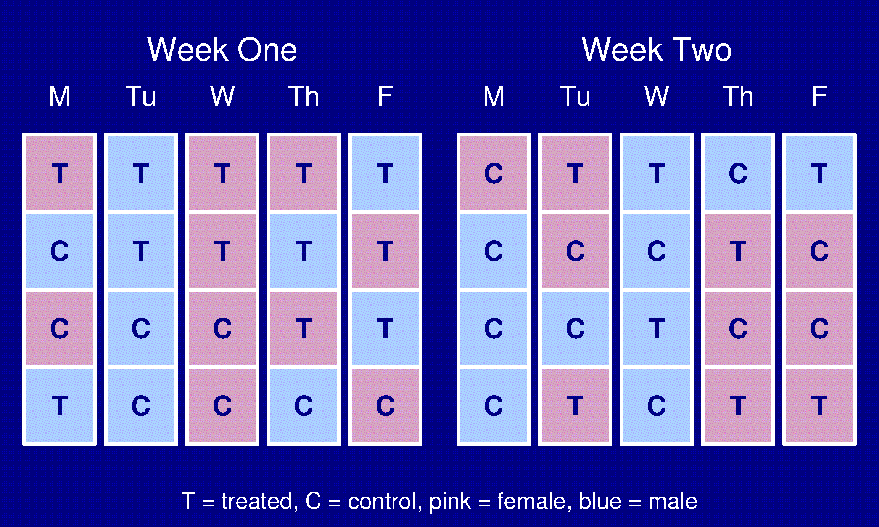
Randomized
23

Slide 24
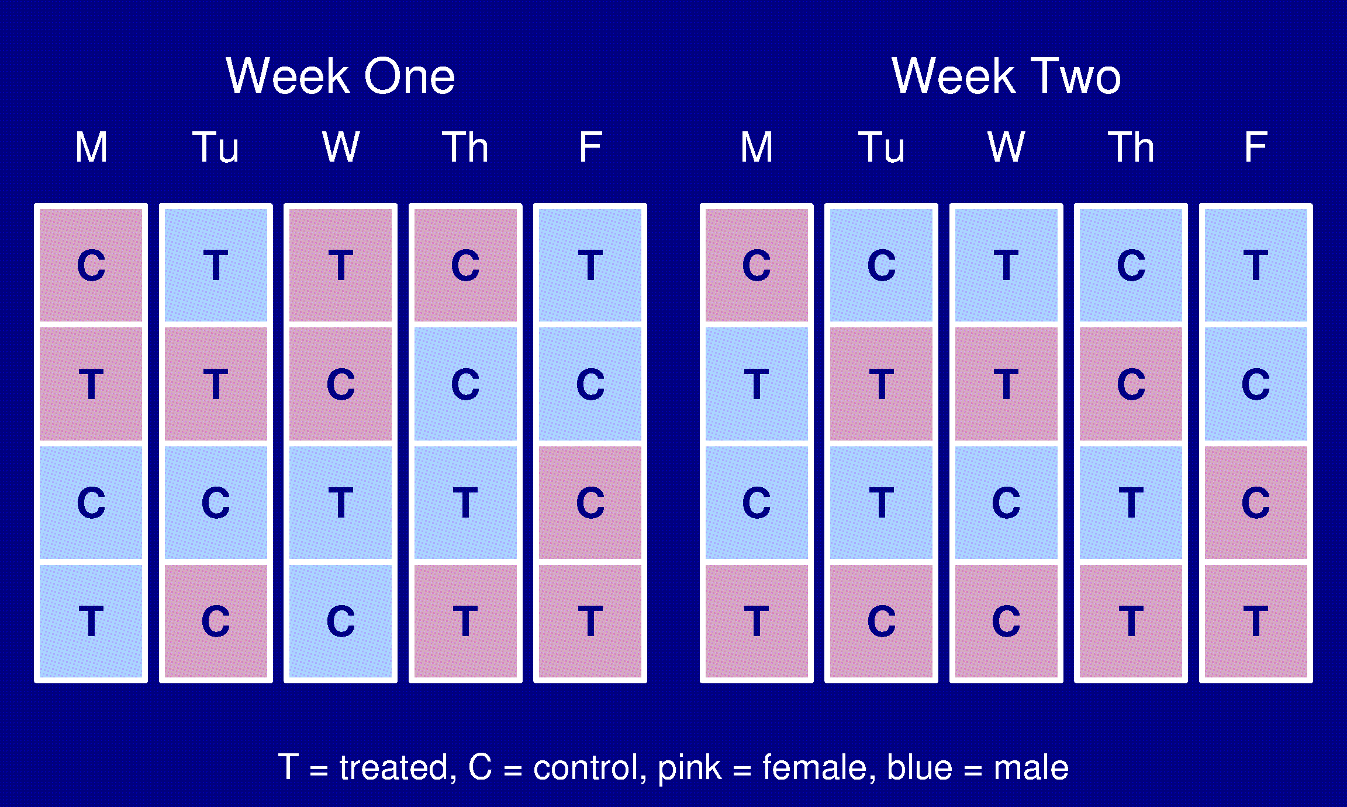
A stratified design
24

Slide 25
Randomization and stratification
If you can (and want to), fix a variable.
  e.g., use only 8 week old male rats from a single strain.
If you don’t fix a variable, stratify it.
  e.g., use both 8 week and 12 week old male rats, and stratify with respect to age.
If you can neither fix nor stratify a variable, randomize it.
25

Slide 26
Factorial Experiments
Suppose we are interested in the effect of both salt water and a high-fat diet on blood pressure.
Ideally: look at all 4 treatments in one experiment.
Plain water Normal diet
Salt water High-fat diet
  2 factors with 2 levels each = 4 treatment groups
  Water + Normal Diet NaCl + Normal Diet
  Water + High-fat Diet NaCl + High-fat Diet
×
26

Slide 27
Factorial Experiments
A factor of an experiment is a controlled independent variable; a variable whose levels are set by the experimenter or a factor can be a general type or category of treatments/conditions.
Examples of factors in lab science research
  Treatment
  Time (Hour, Day, Month)
  Presence or absence of a biological characteristic
    D+ vs. D-
    Wild Type vs. Normal

Slide 28
Factorial Experiments
Adding additional factors leads to:
  Increased sample size
  Reduced Power
  Possible interactions (good and unexplainable)
  Additional complexity in modeling
Why do a factorial experiment?
  We can learn more.
  More efficient than doing all single-factor experiments.

Slide 29
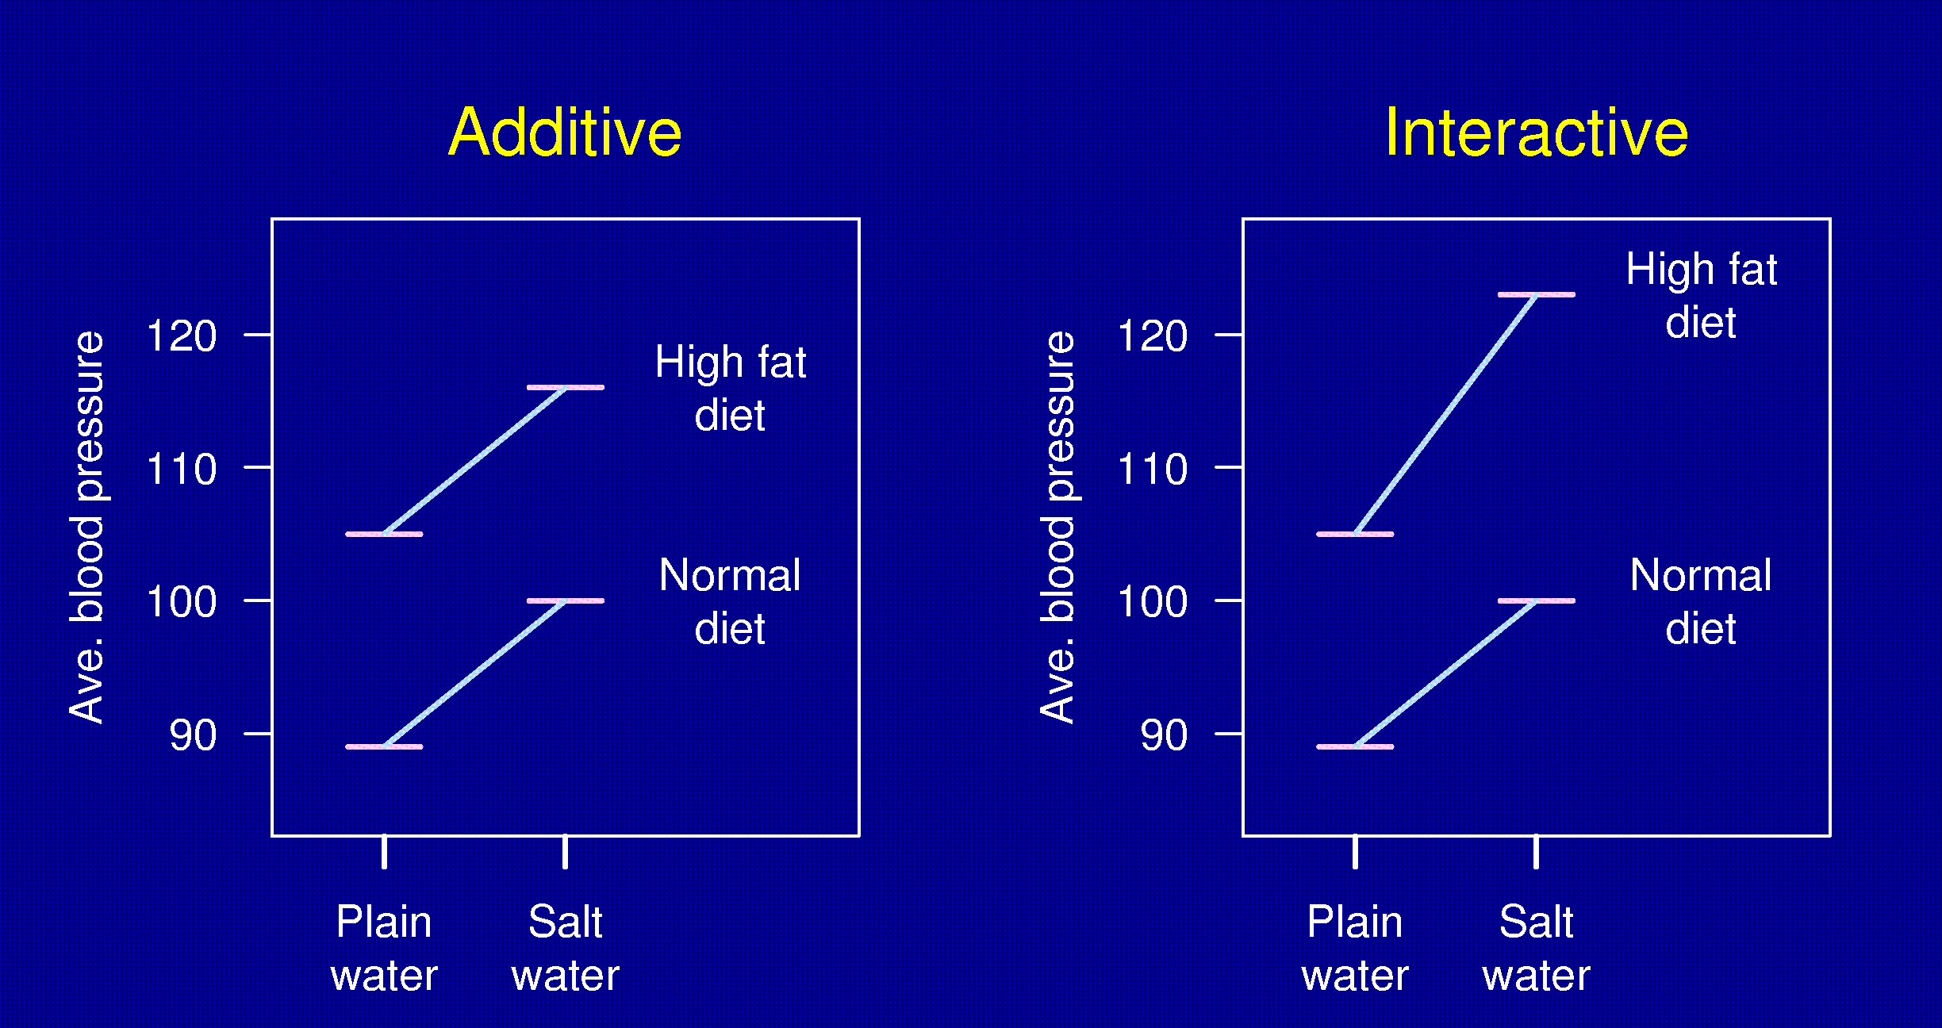
Interactions
29

Slide 30
Statistics for Factorial Experiments
ANOVA
  One-Way
    compare several groups of (independent) observations, test whether or not all the means are equal.
  2 or more factors
    Test for presences of interactions first
      If significant report simple effects
          condition on each factor at a time
      If non-significant, remove from model and examine the main effects
Note: balanced designs are preferable, same n in every group.

Slide 31
Repeated Factors
If you are measuring the same subject repeatedly then observations are not independent
  E.g., Measure BP at 1 hour, 2 hours, 4 hours after initiating treatment
We must account for correlation between observations
Try to only perform experiments with one-repeated factor.
  Increasing the # of repeated factors significantly increases the sample size (have to model large correlation structures which require n

Slide 32
Other points
Blinding
  Measurements made by people can be influenced by unconscious biases.
  Ideally, dissections and measurements should be made without knowledge of the treatment applied.
Internal controls
  It can be useful to use the subjects themselves as their own controls (e.g., consider the response after vs. before treatment).
  Why? Increased precision.
32

Slide 33
Identifying the cut-off to use with a test on the basis of panel analysis: Real case
Cut-off
25
20
False negatives
False positives
15
Sick
True negatives
Number of tests
10
Well
True positives
5
0
1
2
3
4
5
6
7
8
9
10
11
12
13
14
Possible values of the test

Slide 34
Characteristics of a diagnostic test
Sensitivity and specificity matter to laboratory specialists
  Studied on panels of positives and negatives
  Look into the intrinsic characteristics of the test:
    Capacity to pick affected
    Capacity to pick non affected
Predictive values matter to clinicians
  Studied on homogeneous populations
  Look into the performance of the test in real life:
    What to make of a positive test
    What to make of a negative test

Slide 35
Summary of Experimental Design
Characteristics of good experiments:
Unbiased
  Randomization
  Blinding
High precision
  Uniform material
  Replication
  Stratification
Simple
  Protect against mistakes
Wide range of applicability
  Deliberate variation
  Factorial designs
Able to estimate uncertainty
  Replication
  Randomization
35

Slide 36
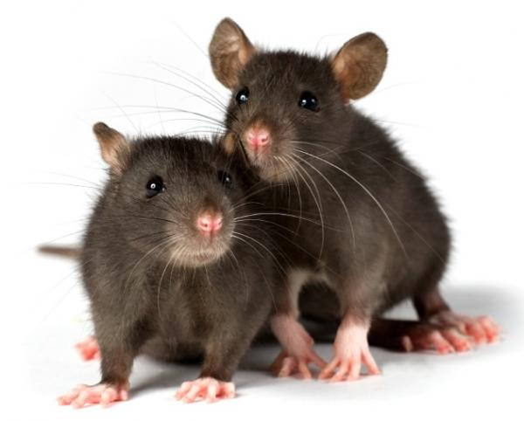
Sample size determination
36

Slide 37
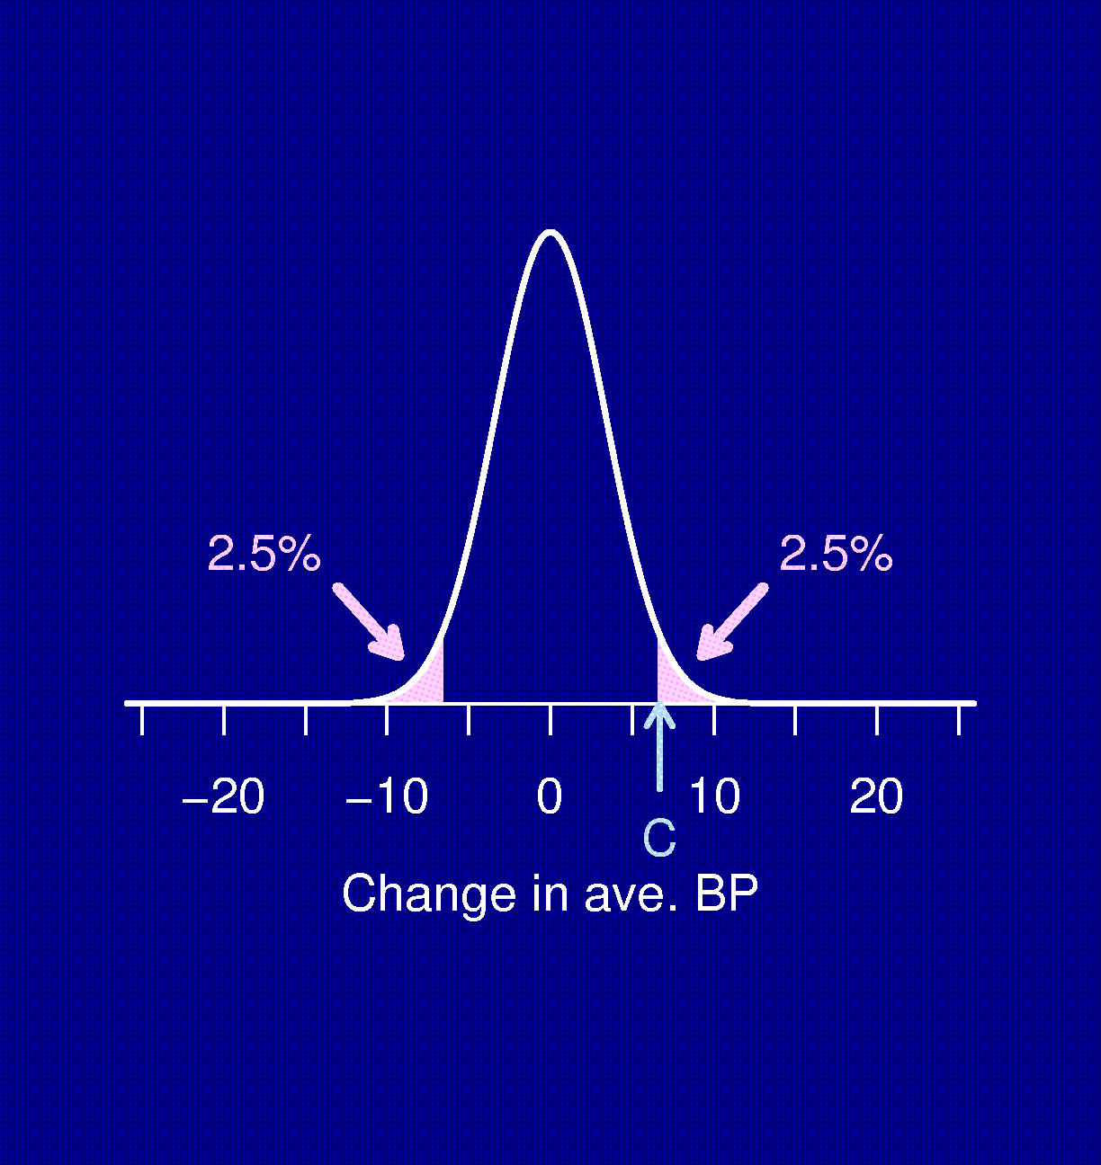
Significance test
Compare the BP of 6 rats fed salt water to 6 rats fed plain water.
Δ = true difference in average BP (the treatment effect).
H₀: Δ = 0 (i.e., no effect)
Test statistic, D.
If |D| > C, reject H₀.
C chosen so that the chance you reject H₀, if H₀ is true, is 5%
Distribution of D when Δ = 0
37

Slide 38
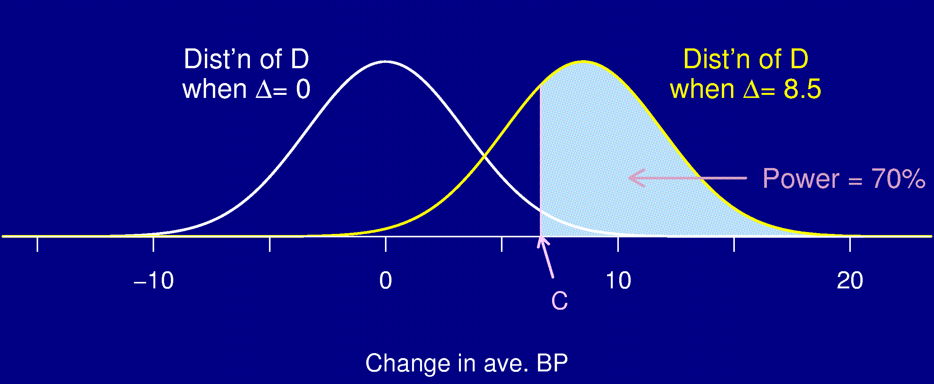
Statistical power
Power = The chance that you reject H₀ when H₀ is false (i.e., you [correctly] conclude that there is a treatment effect when there really is a treatment effect).
38

Slide 39
Power and sample size depend on…
The design of the experiment
The method for analyzing the data (i.e., the statistical test)
The size of the true underlying effect
The variability in the measurements
The chosen significance level (α)
The sample size
39

Slide 40
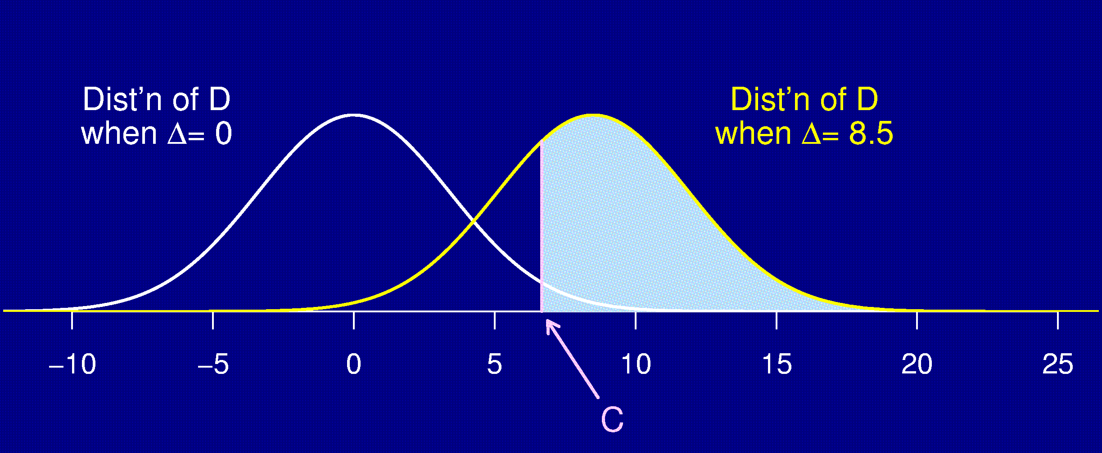
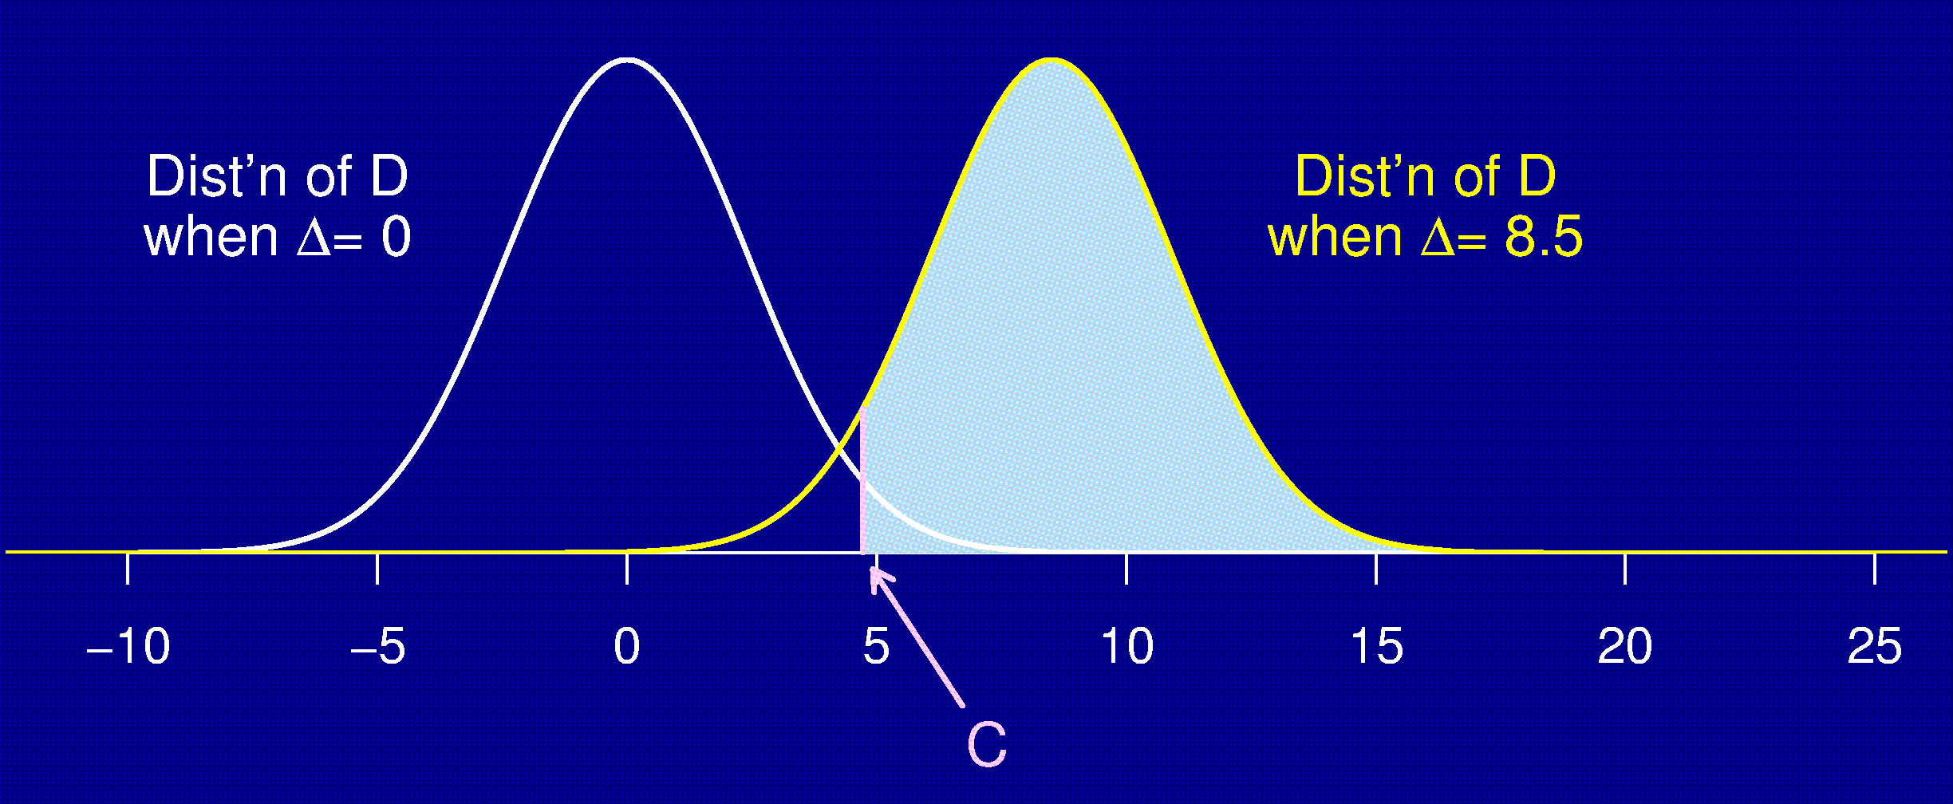
Effect of sample size
6 per group:
Power = 70%
12 per group:
Power = 94%
40

Slide 41
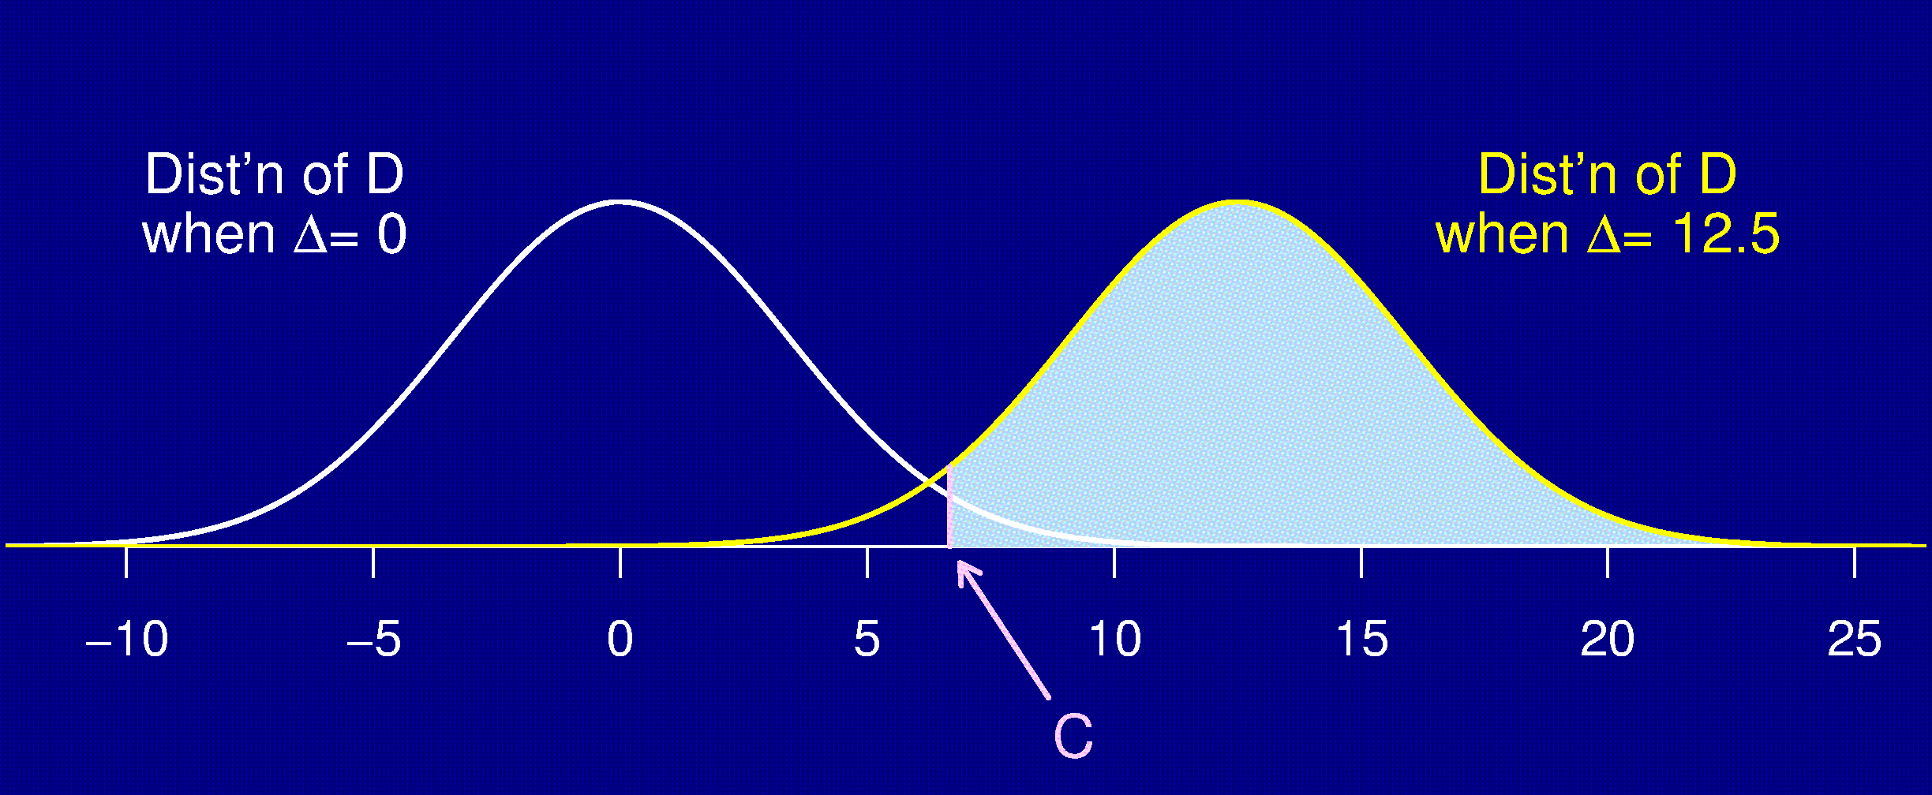
Effect of the effect
Δ = 8.5:
Power = 70%
Δ = 12.5:
Power = 96%
41

Slide 42
Various effects
Desired power ↑ ⇒ sample size ↑
Stringency of statistical test ↑ ⇒ sample size ↑
Measurement variability ↓ ⇒ sample size ↓
Treatment effect ↑ ⇒ sample size ↓
42

Slide 43
  What do I need to a sample size / power calculation?
Pilot Data
Study Design
List of variables interested in studying
Proposal or basic summary of research goals
Measure of the effect you want to detect for each research hypothesis
  Means and standard deviations for each group
  Odds Ratio between treatment and control group
  Expected proportion of event in each group
  Estimate of correlation between two variables
  General effect size you want to detect (most broad)
    Small <0.2; Moderate 0.2 – 0.5; Large >0.5

Slide 44
Reducing sample size
I can’t afford 100 rats ….
Reduce the number of treatment groups being compared.
Find a more precise measurement (e.g., average time to effect rather than proportion sick).
Decrease the variability in the measurements.
  Make subjects more homogeneous.
  Use stratification.
  Control for other variables (e.g., weight).
  Average multiple measurements on each subject.
44

Slide 45
Summary of Sample Size
The things you need to know:
  Structure of the experiment
  Method for analysis
  Chosen significance level, α (usually 5%)
  Desired power (usually 80%)
  Variability in the measurements
    if necessary, perform a pilot study, or use data from prior publications
  The smallest meaningful effect
45

Slide 46

Data Management
46

Slide 47

Database Management
Capacity | Microsoft Excel | Microsoft Access | REDCAP
Emory Supported
Good for small Studies
Free
Secure
Best for longitudinal data
Flexible
Anyone can operate
Web-based interface

Slide 48
Database Design/ Data Entry
Good Data Entry Practices
Determine the format of the database ahead of time
    One or two time points
      Short and Fat
      Use only if a few measurements are duplicated
    Multiple Time Points (longitudinal)
      Long and Skinny
Variable names should be:
    Short but informative
    Have consistent nomenclature
Missing data should be left blank
    DO NOT use “99” or NA for missing data.
    Pay attention to variables < or > LOD

Slide 49
Database Design/ Data Entry
Good Data Entry Practices (continued)
Make sure the dataset is complete before sending it off to be analyzed.
    Adding/Deleting observations can greatly affect results and tables
Provide a key along with the database
    Defines numerical coding such as race categories or gender
    Identifies where important variables are located in the database
Avoid using multiple spreadsheets.
    Try to group as much information on one spreadsheet

Slide 50


Database Design/ Data Entry
Example 1 Short and Fat
  Best for prospective studies with little to no repeated measurements.
Example 2 Long and Skinny
  Best for longitudinal or prospective studies with multiple repeated measurements or
Example 3 Bad Example
  Common mistakes made.

Slide 51
Questions?

Slide 52
Acknowledgement
This presentation was adapted from Karl Broman’s lecture on Experimental Data.
This is part of a free lecture series from John Hopkins School of Public Health’s Open Courseware. For more information about additional lecture content from Dr. Broman please go to:
http://ocw.jhsph.edu/courses/StatisticsLaboratoryScientistsI/lectureNotes.cfm

