Slide 1
Study Start-Up and Implementation
PEARLS December 9, 2016

Slide 2
Panelists
Saadia Khizer, MBBS, MPH, CCRC, Lead Research Coordinator, Scottish Rite (saadia.khizer@choa.org)
Jaclyn M. Smith, MBA, CCRP, Research Manager, Aflac (Jaclyn.smith@choa.org)
Margaret Kamel, PhD, CHES, CCRC, Clinical Research Coordinator IV, Emory (mkamel@emory.edu)
Eric Hoar, RRT, CCRP, Lead Research Coordinator, Egleston (eric.hoar@choa.org)

Slide 3
Study Start-Up Overview
Interest in Study
CDA
Start-up procedures
Budget and Contract Routing
Pre-Enrollment
Feasibility
Regulatory Binder
Approval (IRB, ACTSI, etc)
Pre-study Visits
Source Documents
Integration into Systems (EPIC, CTMS, CR-Assist, etc.)
Training
Site Initiation Visit

Slide 4
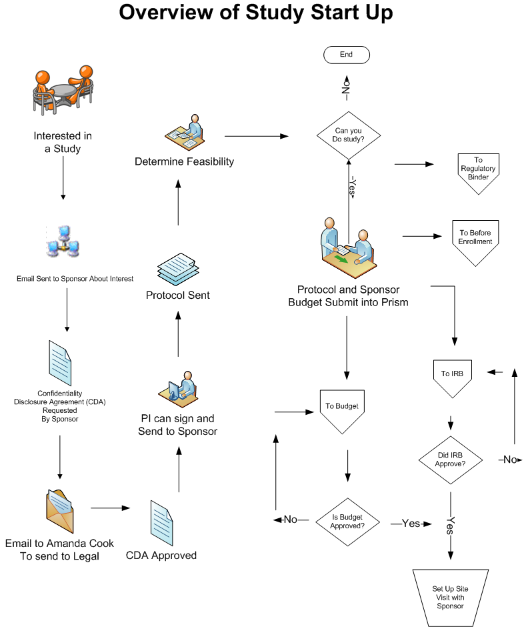

Slide 5
Interest in Study

Slide 6
What is the CDA?
Confidential Disclosure Agreement (CDA)/Non-Disclosure Agreement (NDA): Legal agreement between at least two parties which outlines information the parties wish to share with one another for certain evaluation purposes, but wish to restrict from wider use and dissemination.
Often required prior to release of the full protocol
Once the CDA/NDA is received, forward sponsor email and attachment:
For Emory PIs: send to Amanda Cook at amcook@emory.edu and she will forward to the Emory contracts office
For CHOA PIs: send to OSP@choa.org
The respective contract office will negotiate the language directly with the sponsor and inform the PI when ready to sign

Slide 7
Determine Feasibility
Clinical trial feasibility is a process of evaluating the possibility of conducting a particular clinical trial in a particular region with the overall objective of optimum project completion in terms of timelines, targets and cost.
Feasibility Analysis
Things to consider:
Experience with the sponsor/clinical research organization
Population
Protocol
Procedures
Staff
Space
Budgets
Protocol Feasibility Checklist Sample
Source: http://www.ohsu.edu/xd/research/centers-institutes/octri/resources/policies-forms/upload/1FeasCklst012113.pdf
Source: https://www.ncbi.nlm.nih.gov/pmc/articles/PMC3146075/
Notes:
Document the meeting regarding review of feasibility with the team

Slide 8
Pre-Study Visits
Pre-study visits (PSV): Site Selection Visit (SSV) or Site Qualification Visit (SQV)
Conducted to determine if the investigator and clinical site have the capability to conduct the study
The coordinator and investigator must be available
Pharmacy staff and other ancillary services staff may need to be available as well
How to prepare:
Identify a meeting space for the monitor to review the protocol with the research staff
Schedule time with the appropriate ancillary services (i.e.-investigational drug services, in-patient units, materials management, etc.)
Visits may last from 3-6 hours dependent on the complexity of the study, number of sites subjects will be seen, number of ancillary services required, etc.
Become familiar with essential equipment (which MRI scanners does CHOA have, what freezers are available, centrifuges, PRC equipment etc)
Make available certain documents that the sponsor may want to see

Slide 9
Start-up Procedures
*Activities can be conducted simultaneously

Slide 10
Budget and Contract routing
The investigator CANNOT sign a contract or finalize a budget on behalf of the academic institution.
The budget and contract must be routed through Research Administration
For Emory PIs, the study team completes the Intent to Submit form
Clinical Trails: Submit study into the Pediatric Research Initiation system (PRISM) once all documents have been received by the sponsor (FINAL protocol, contract and budget) and the appropriate division/departmental approvals have been obtained to move forward with the study.
Grant Proposals: Submit the study 30 days prior to agency deadline, 60 days prior for complex awards.
For CHOA PIs, complete steps Children’s Proposal Routing Checklist
No subject should be enrolled prior to having an executed CTA. If your study has CHOA billables, no pediatric subjects should be enrolled prior to the execution of the subcontract.
Recommendation: Create a separate small binder to keep track of the budget, receipts, invoices etc.
Notes:
Unlike grants, you will not receive a large lump sum of money. If you are planning to hire a coordinator to conduct the study, please be aware that you won’t see that money until after the study has been initiated and activities are being completed

Slide 11
Approvals
Study Being Done at ACTSI Center?
Pediatric Research Center
http://www.actsi.org/discovery/protocol-submission.html
What needs IRB approval?
All documents pertaining to the conduct of the clinical trial
Include any documents that the patient will see/be given (drug instructions, advertisements, etc.)
PEARLS IRB Submissions Q & A

Slide 12
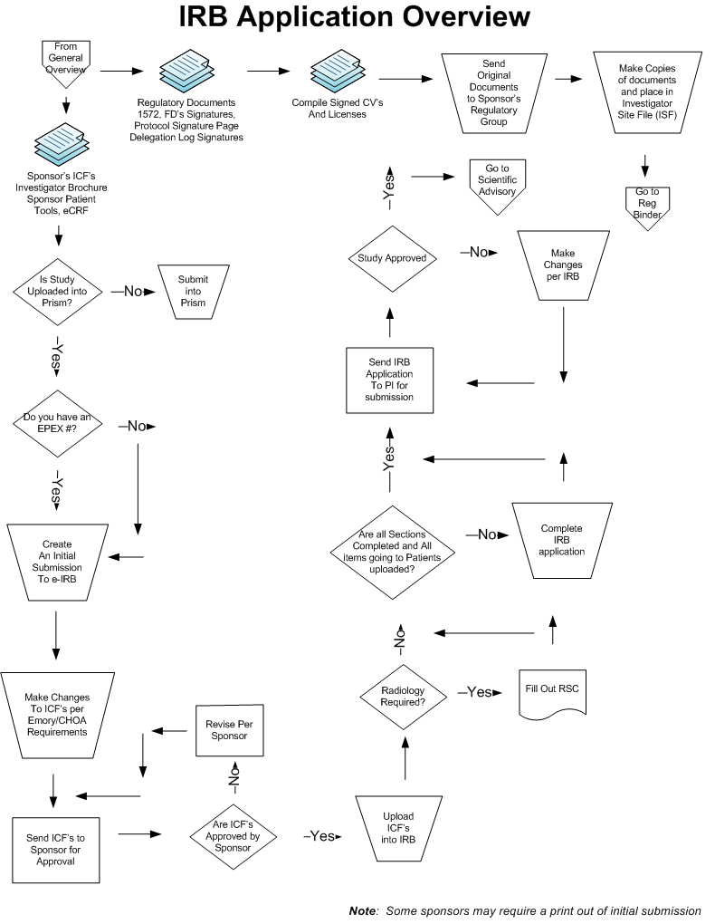

Slide 13
Pre-Enrollment

Slide 14
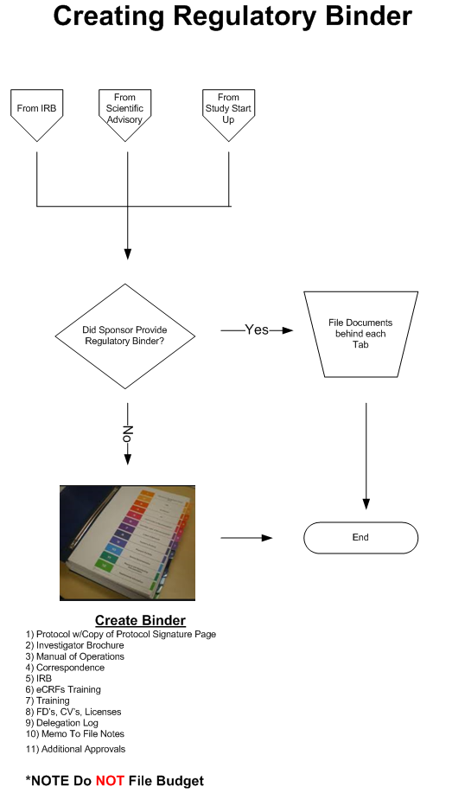

Slide 15
Essential Documentation
Essential Documentation: Documents that individually and collectively permit evaluation of the conduct of a study and the quality of the data produced
The following documents should be generated and should be on file before the trial formally starts
Signed trial agreement
Pre-trial monitoring report
Investigators Brochure
Information given to subject
Informed Consent and applicable translations and translation certificates
Other written material (home drug administration instructions, subject diaries, etc.)
Dated, documented approval/opinions of the institutional review board (IRB)
See Section 8 of the ICH E6 Guidelines: "Essential Documents for the Conduct of a Clinical Trial” for full list.
Source: ICH E6 Guidelines

Slide 16
Source Document Development
Source data should:
Collect data outlined in the final protocol
Be clear and concise with data questions
Standardize how information is collected
Be Attributable, legible, contemporaneous, original, and accurate (ALCOA)
Avoid duplication
Be well-structured
Be Easy to complete
Clinical Trial Tools-Developed by Emory Compliance and Emory Clinical Trials Audit and Compliance (CTAC)
Access to data is critical to the review for inspections of clinical investigations and must meet regulatory requirements for record keeping (i.e.-maintaining audit trail)
Review any CRFs the sponsor provides to help develop source documents. CRFs may include details that are not outlined in the protocol, such as processing times, that the sponsor wants to capture.

Slide 17
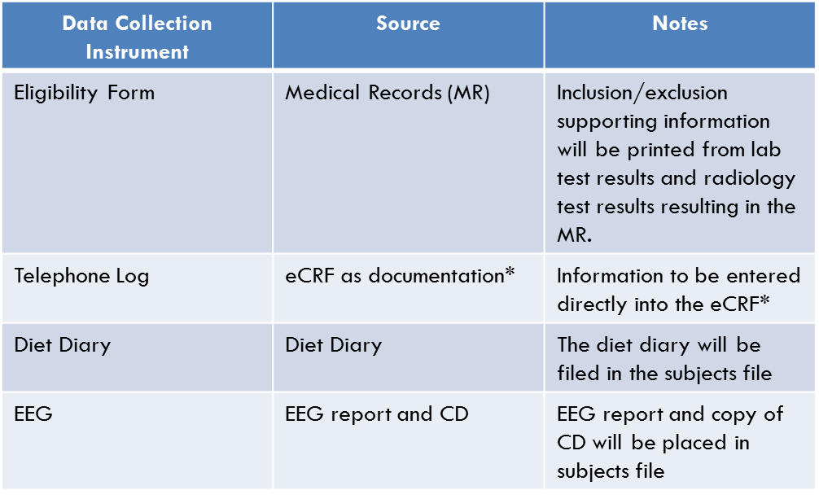
Study Documentation Plan
Develop a plan outlining the following
Describe the instrument used to collect the data
Describe the source of the data (i.e. medical record, lab report, subject diary, etc.)
List instructions on where and how data will be stored

Slide 18
Site Initiation Visit (SIV)
Conducted when a research site is ready to be activated for recruitment
Usually occurs after the site has completed all regulatory requirements, has IRB approval, and an executed contract
Last step before the study site is activated for enrollment by the sponsor

Slide 19
Other things to consider
Contact Meredith Capasse for CTMS requirements and questions at CTMS@choa.org
Ensure order sets for EPIC are completed prior to enrolling the first subject. Contact the IS&T solution center at 404-785-6767 or submit the online request form.
If utilizing the PRC, ensure your study has been entered into the scheduling system, CR-Assist
Training-Does the study require additional training? (i.e.-lab safety, EKG, etc.)
Supplies-Ensure you have received all study supplies needed to conduct the trial
Logistics-Confirm location and processes for study activities

Slide 20
Additional activities upon approval of study
Once a notice of award (NOA) is issued for a clinical trial, a project enrollment tracker must be created and updated after each patient visit. Project Enrollment Tracker Procedures
Email the CHOA IRB Authorization Agreement (IAA) Reliance Acknowledgement Form to irb@choa.org. This form is used for new studies that have an IRB Authorization Agreement (IAA) with another institution, or when your research falls under the umbrella agreement with Emory, Georgia Tech, or Morehouse.
Enter your study into the Enrollment and Visit Tracking Database
Complete the ERMS Activation Form. ERMS is a web-based clinical research financial management tool used to assist Emory Healthcare and Emory University with their joint research billing compliance program. It facilitates communication of subject enrollment and study visit activity by the research team with the billing departments. If you have an Emory PI and they will conduct a pediatric clinical trial, the form must be completed.

Slide 21
Study Start-up Tools/Tips
TIPS
Track submission and approval dates
Develop checklists for each visit from the final protocol
Create a quick reference study guide/binder that includes the source documents and quick reference to protocol
Create a separate small binder to keep track of budget, receipts, invoices, etc.
TOOLS
Emory University tools for clinical trials
Sample Feasibility Form
ICH G6 Guidelines
Scientific Advisory Committee (SAC) Application Overview
Research Coordinator Resources
EPIC Monitor Access
Online Request form for Solution Center (located on careforce)

Slide 22
Questions

Slide 23
Advice from panelists
Saadia Khizer:
Hughes Spalding has a different process, contact her directly for instructions
Always download the most current versions of forms from websites, don’t rely on saved copies
Working with Gigi during the CHOA Coverage Analysis process will help determine which ancillary groups are needed and highlight potential issues to your timeline
Do not always go with the sponsor’s timelines as they are usually only focused on their one study, learn to do your own prioritization
Try to schedule site initiation visits close to enrollment so training is not forgotten

Slide 24
Advice from panelists
Jackie Smith:
It is important to engage with everyone along the process
All pre-award processes should be started at the same time (budget, IRB, contract, other submissions such as PRC, etc)
Make sure the Emory investigator is engaging with the RAS
You must submit the contract, budget and final contract to the RAS for clinical trials before they will begin work
Site to check status of Emory contract (use Emory account to log in): http://osp.emory.edu/systems/ects.html

Slide 25
Advice from panelists
Margo Kamel:
Reconcile the Schedule of Events in the protocol with what is described in the protocol to resolve any discrepancies ahead of time
Utilize checklists!
For sponsor visits, make sure you schedule appointments ahead of time as some may need up to 2 weeks notice
If ancillary department appointments cannot be made or your study team is not available, do not be afraid to tell the sponsor their visit has to be rescheduled

Slide 26
Advice from panelists
Eric Hoar:
Check with the ancillary groups to see if any special training will be needed
Sometimes protocol required procedures may require additional items that need to be included on the coverage analysis and budget (example: a research biopsy means you also will need pre-op labs)

