Slide 1
K-Club
Navigating the Career Arc
10/14/2024

Slide 2
Survey Drawing

Slide 3
Survey Drawing
September Winner:
Julie Gliwinski

Slide 4
K-Club Special: American Heart Association Career Development Award
This grant supports highly promising healthcare and academic professionals, in the early years of one’s first professional appointment, to explore innovative questions or pilot studies that will provide preliminary data and training necessary to assure the applicant’s future success as a research scientist.
The awardee must devote at least 10% effort to the Career Development Award.
$77,000 per year, including 10% institutional indirect costs
Deadline: December 05, 2024 4 pm
More Information Here

Slide 5
K-Club Special: Alex’s Lemonade Stand: Young Investigator Grant
The Young Investigator grant is a three-year award designed to support early career researchers, such as postdoctoral fellows, clinical fellows or instructors, pursuing promising childhood cancer research ideas. These grants aim to cultivate the best and brightest researchers of the future who demonstrate a commitment to a research career in pediatric cancer. A mentor is required, and a career development plan must be included.
Applicants must have an MD, PhD, or MD/PhD or equivalent and must not have achieved an appointment higher than Instructor. Assistant Professors, including adjuncts at this level, will not be considered.
Up to to $60,000 in direct costs per year for three years.
Deadline: December 12, 2024, 8 PM
More Information Here

Slide 6
K-Club Special: Georgia CTSA KL2
Scholars program will receive salary support to enable them to spend at least 75% of their professional time (50% is allowed for trainees from surgery or surgical subspecialties) on clinical and translational research (CTR)/clinical and translational science (CTS) and research training. They will also receive a KL2 technical budget of $25,000 per year for research-related expenses and tuition for the Master of Science in Clinical Research (MSCR) degree or Certificate Program in Translational Science (CPTS) programs.
The candidate must:
Be a full-time junior faculty member at Emory University, Morehouse School of Medicine, Georgia Institute of Technology, or University of Georgia (Instructor or Assistant Professor or equivalent level) at the time of receipt of the award
Indicate a strong interest in pursuing a career in clinical and/or translational research
Be nominated by the candidate's Department Chair
Identify an established Emory, MSM, Georgia Tech, or UGA faculty lead mentor who meets approval criteria. Additional faculty members may serve as co-mentors or Advisory Committee members but there must be a designated single lead mentor.
Deadline: Feb 3, 2025 5 PM
Two-part workshop on October 17 and October 24, in person from 9:30-11:30
Click here to register: https://form.jotform.com/242476360042148
More Information Here

Slide 7
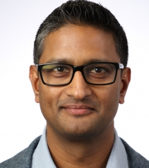
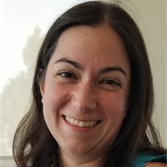
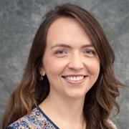
October K-Club
Navigating the Career Arc
Bonney Reed, PhD
Associate Professor,
Pediatrics
K23>R03>R01
Satheesh Chonat, MD
Associate Professor,
Pediatrics
K12>R21>R01
Vasiliki Michopoulos, PhD
Associate Professor, Psychiatry and Behavioral Sciences
F31>Predoc TL1>K12 BIRCW-> R01>U54 (research project MPI, not overall PI)>teaching a course on advanced grant writing

Slide 8
Today’s Learning Objectives
1. Appreciate different pathways that can lead to an independent research career.
2. Learn practical steps and best practices that will help you achieve research independence.
3. Seek answers from researchers who have successfully navigated the research funding path to independence.

Slide 9
Different Pathways
There is no one path to research independence
Some paths are relatively straight; most are probably a bit winding and/or sometimes feel wobbly
You might start on one path and find yourself on another

Slide 10
Questions for Panelists: The Pathway
In what ways, if any, does the path you took to research independence differ from what you planned?
How crucial was the planning of the pathway? What about being willing to adapt to obstacles along the way?
What do you consider the critical parts of your own funding path that led you to securing your own independent funding?
Pilot data
Foundation Grants or pilot funding
Working with others on their funded grants

Slide 11
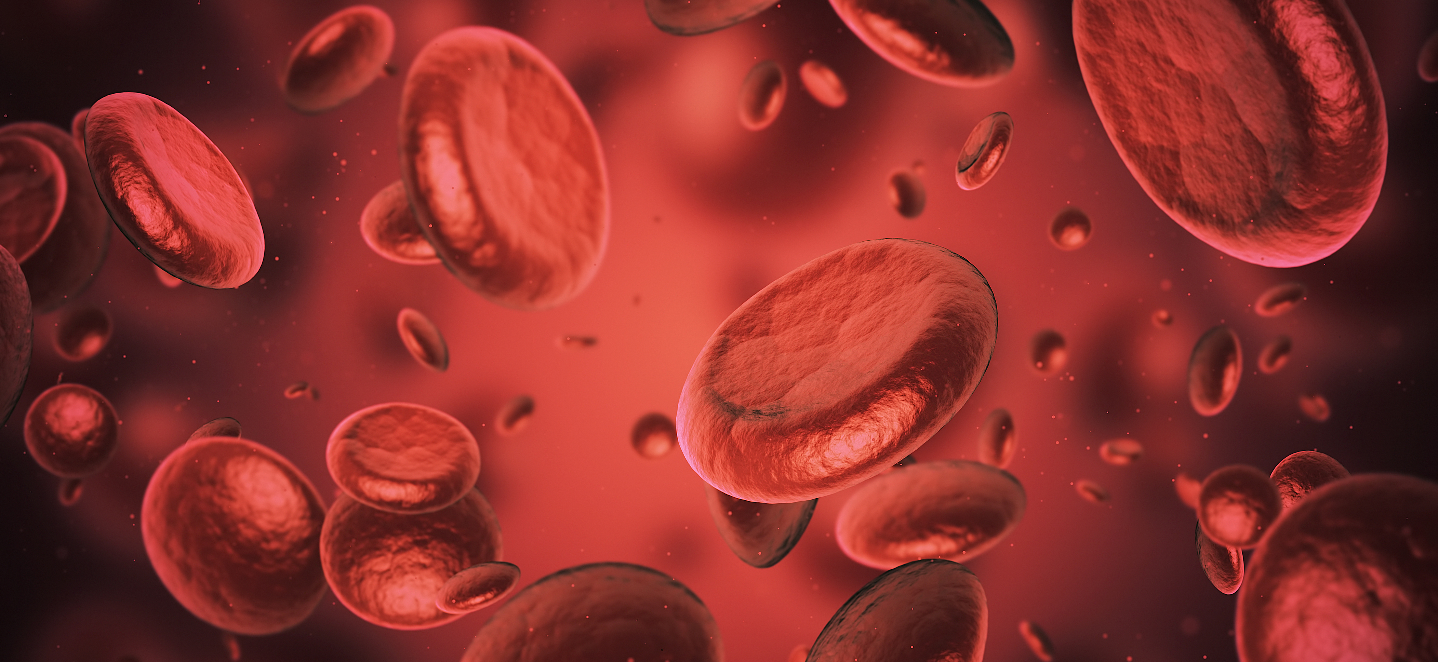
Some Determinants of the Pathway
Mentors
The Research Itself
Career Goals
Individual Motivations
Interests

Slide 12
The Importance of Mentors
Career Support
Research Support
Psychosocial Support

Slide 13
Questions for Panelists: Mentors
What was the right number of mentors for you?
Once you were funded, how did you use them?
How frequently did your mentor team and entire team meet?
In what meaningful ways did you engage your mentors/did they engage you while working towards independence?
What people other than your mentor were instrumental in helping you move to independence?
How did you go about building those relationships?

Slide 14
Following the Research
Keeping an open mind
Knowing when to pivot
Differentiating your research from your mentor’s

Slide 15
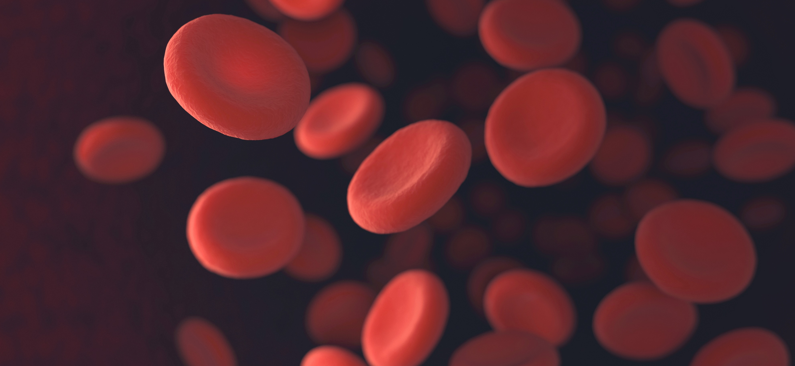
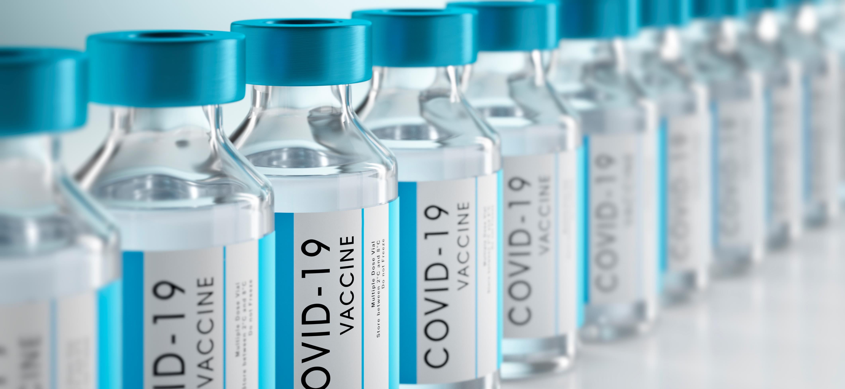
Questions for Panelists: Following the Research
Was your CDA research specialized versus broad focused?
How did you differentiate your own research path from your mentor’s?
Was it up front and deliberate, or did it organically develop along the way?
Did you have a purposeful and deliberate conversation with your mentor, or did it happen more organically?

Slide 16
Obstacles on the Pathway
Time
Clinical Duties
Individual Motivational Changes
Personal Life Pressures

Slide 17
Questions for the Panelists: Obstacles on the Pathway
What did you find was the biggest challenge to meeting your goals?
How did you balance clinical time (if applicable), research time, other professional duties, and your own life?
Did you ever have motivational dips? (if not, we will need that secret sauce). How did you handle and move past those?

Slide 18
Questions from You

