Slide 1
K-Club
SciENcv biosketches and Other NIH Changes: a Hands-on Workshop
4/14/2024

Slide 2
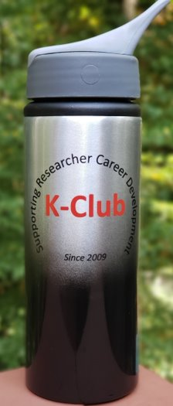
Survey Drawing

Slide 3
Survey Drawing
March Winner: Linda Radbill

Slide 4
K-Club Special: North American Society for Pediatric Gastroenterology, Hepatology and Nutrition Young Investigator Development Awards
Amount: $150,000 ($75,000 per year)
Eligibility:
Be a NASPGHAN member in good standing for at least two years.
No more than five years from fellowship completion (fellowship completed between 7/1/2020 – 9/1/2025). Concurrent completion of advanced fellowship training is not allowed for this award (see below for process to request extension to eligibility).
Hold a full-time faculty position not at the rank of Associate or Full Professor in an academic institution within the United States of America, Mexico or Canada and hold an MD, DO, PhD, MD/PhD, or equivalent degree at the start of the award by September 1, 2025.
Not currently hold or previously be a principal investigator or co-principal investigator on a NIH mentored grant such as a K08, K23, an NIH RO1, PO1 (or similar), or an or equivalent Canadian or Mexican grant mechanisms. Those with concurrent or previous institutional career development awards (KL2, K12, or similar) or Foundation grants are eligible to apply if the proposal does not have scientific overlap.
Not hold another NASPGHAN Foundation grant at the start of the award (Mid-December 2025).
Deadline: July 1, 2025
More Information Here

Slide 5
K-Club Special: The Damon Runyon-Rachleff Innovation Award
The Innovation Award is specifically designed to provide funding to extraordinary early career researchers who have an innovative new idea but lack sufficient preliminary data to obtain traditional funding. It is not designed to fund incremental advances. The research supported by the award must be novel, exceptionally creative and, if successful, have the strong potential for high impact in the cancer field.
The Stage 1 award will be for two years, $200,000 per year ($400,000 total) with the opportunity for up to two additional years of funding (up to four years total for $800,000). Stage 2 support for years three and four will be granted to those awardees who demonstrate progress on their proposed research during years one and two of the award.
Deadline: July 1, 2025
More Information Here

Slide 6
K-Club Special: 2025 Early Career Researcher Conference
Child health researchers who are at any stage in pediatric research training (including undergraduate students, graduate trainees, medical students, residents, medical fellows, post-doctoral fellows (PhD), and junior faculty with a rank of no higher than assistant professor) are encouraged to submit an abstract as the lead author.
Select abstracts submitted by residents and medical fellows (MD), post-doctoral fellows (PhD), and junior faculty may be invited to give oral presentations.
All submissions will be considered for rapid-fire (mini) and poster presentations. Depending on the number of submissions, and due to conference space and time limitations, the number of abstracts selected may be capped this year.
Abstracts that have been prepared or presented at other events (encore abstracts) are eligible.
New to writing an abstract? Visit our Abstract Tips page for more information.
Abstract Deadline: May 2, 2025, 5 PM
Event: September 9, 2025, 8-5
More Information Here

Slide 7
April K-Club
SciENcv biosketches and Other NIH Changes: a Hands-on Workshop
Julie Hawk, PhD
Proposal Development Associate and Director, Pediatric Research Development Core
Emory University
Department of Pediatrics

Slide 8
SciENcv Requirement Updates
Originally set to go into effect May 25
Now postponed with no other information available
Likely WILL still go into effect soon(ish)
Regardless: you can already use SciENcv to create your biosketch, and it is worth making the transition now

Slide 9
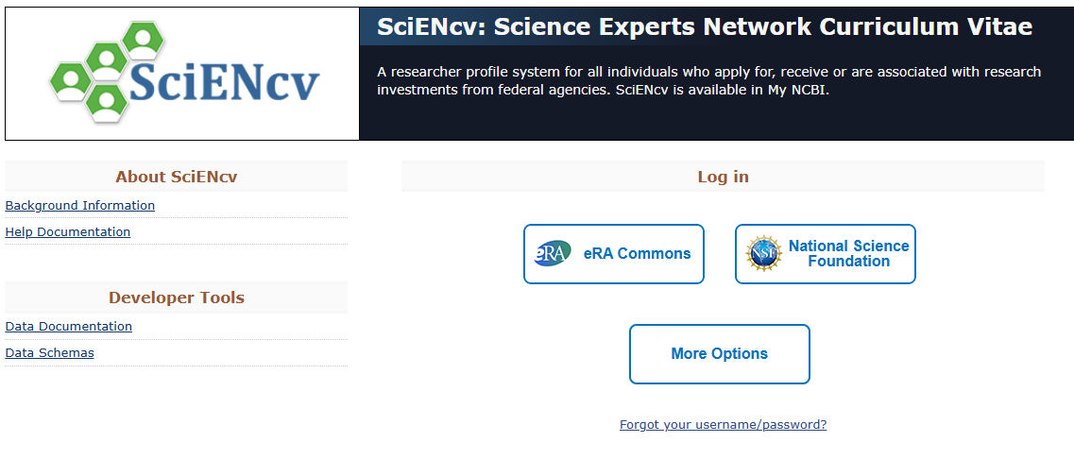
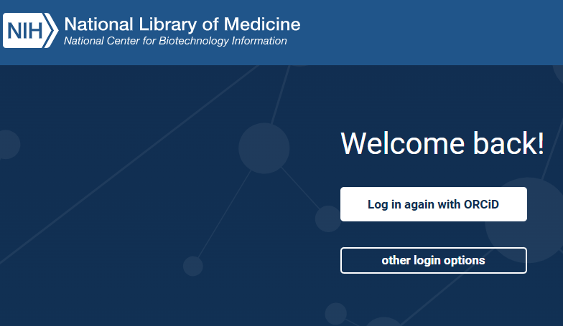
How to log in to SciENcv

Slide 10
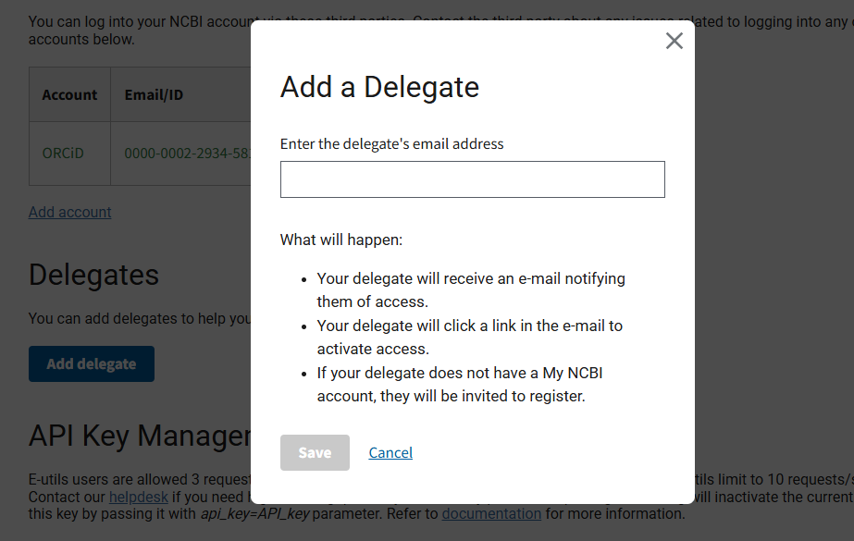
Adding delegates

Slide 11
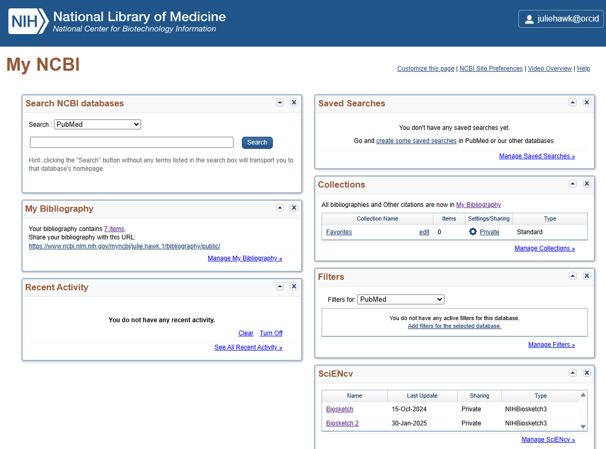
Inside SciENcv

Slide 12
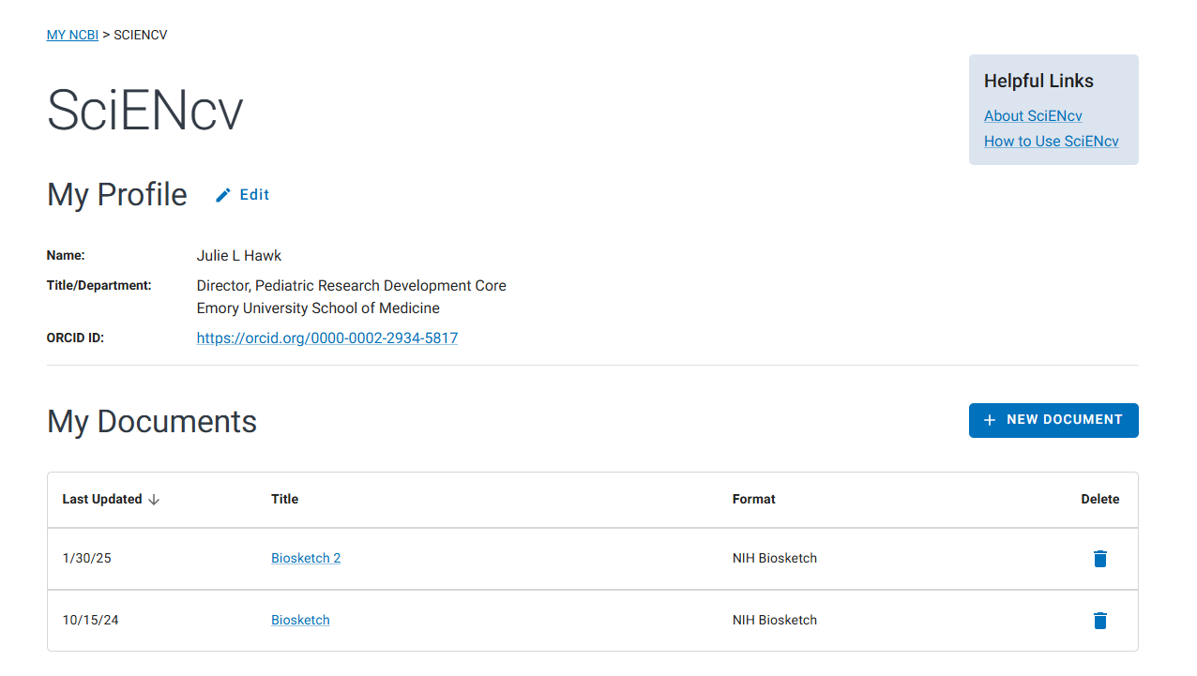
Your Profile in SciENcv

Slide 13
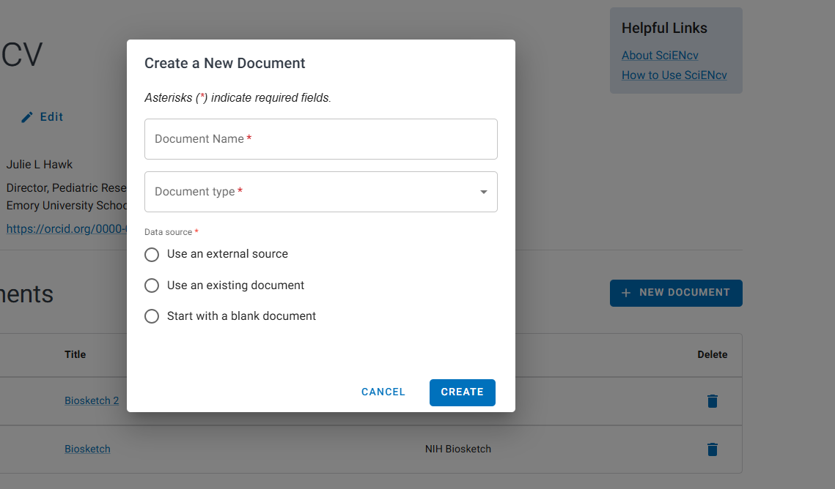
Creating a new document

Slide 14
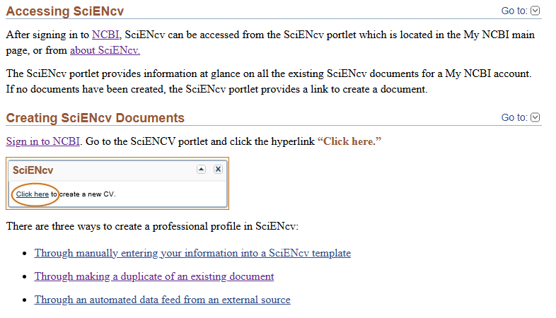
Three ways to create the biosketch

Slide 15
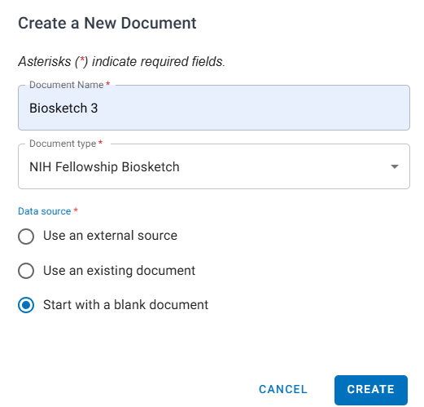
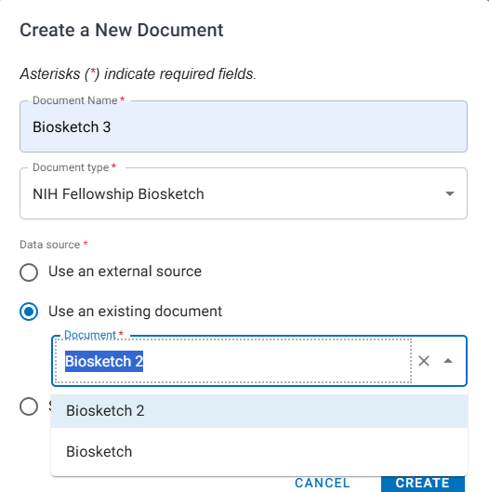
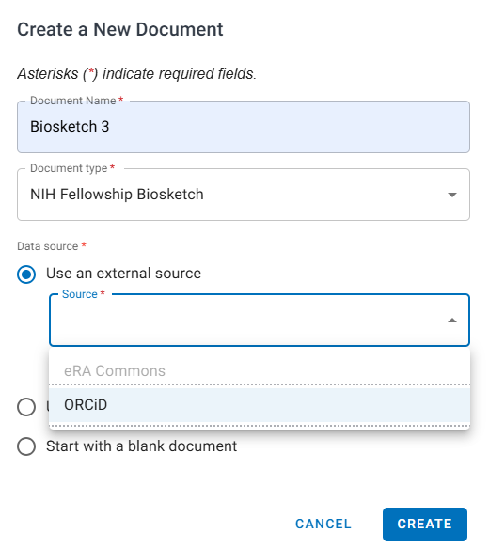
Three ways to create the biosketch

Slide 16
Adding Education and Training manually

Slide 17
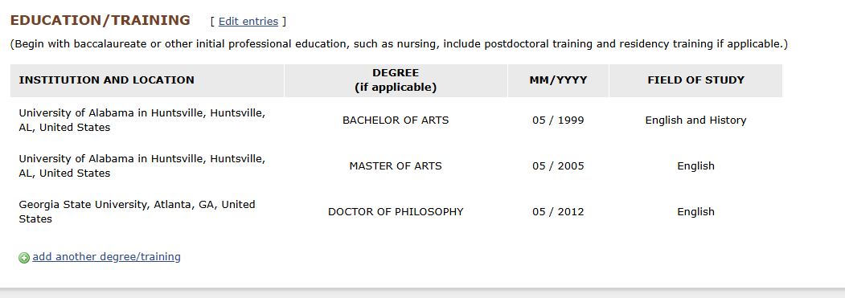
Adding Education and Training manually

Slide 18
Adding Personal Statement manually

Slide 19
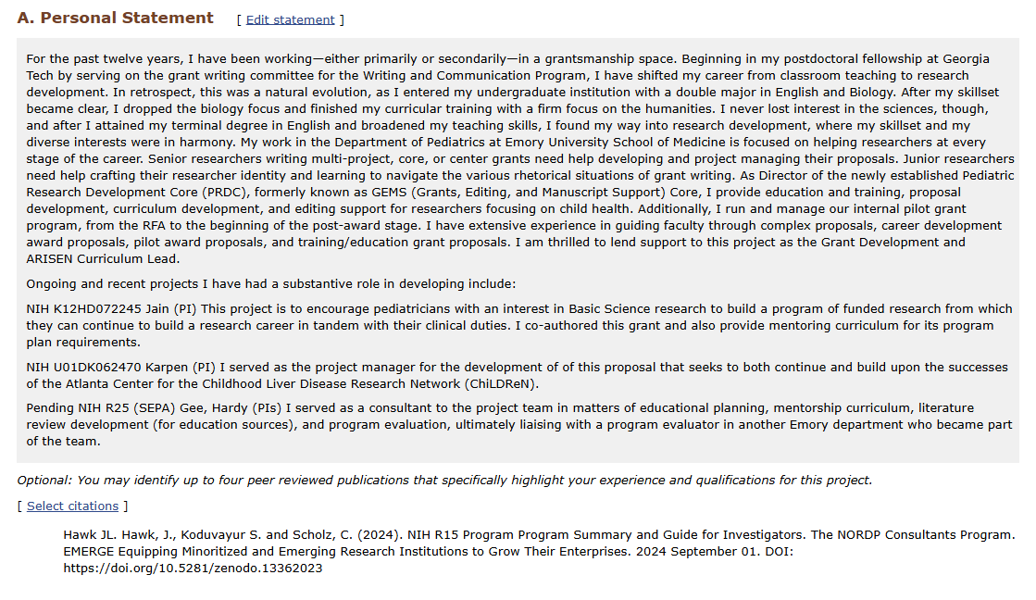
Adding Personal Statement manually

Slide 20
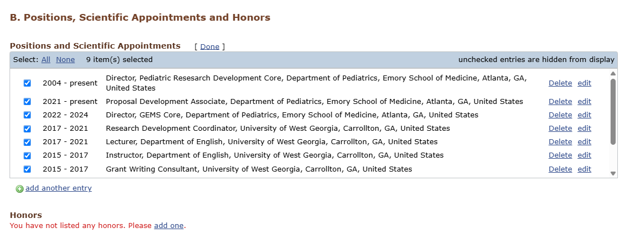
Adding Contributions to Science manually

Slide 21
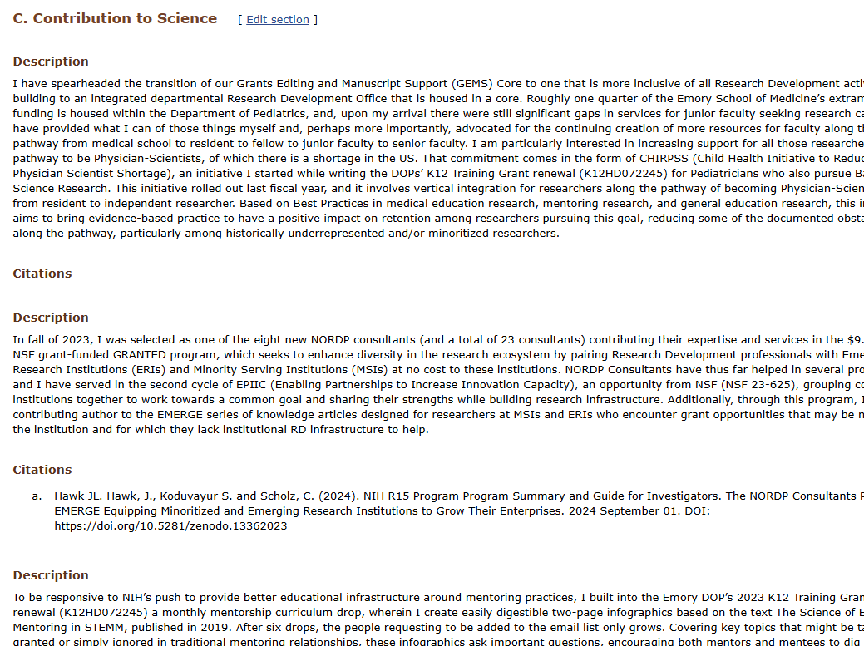
Adding Contributions to Science manually

Slide 22
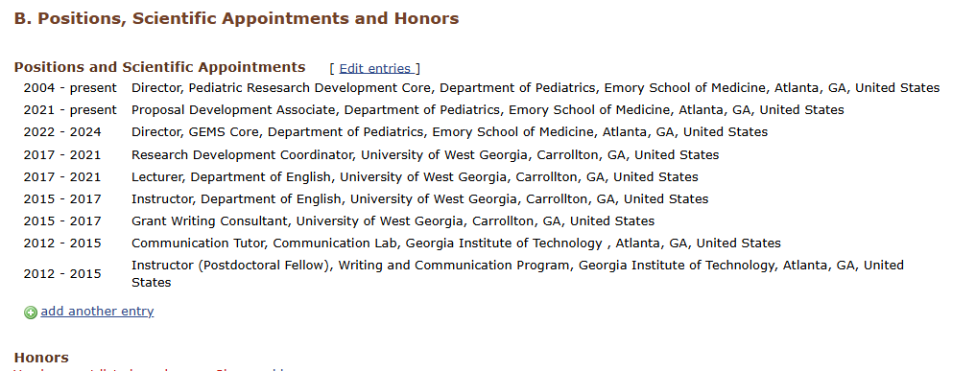
Adding Positions and Honors manually

Slide 23
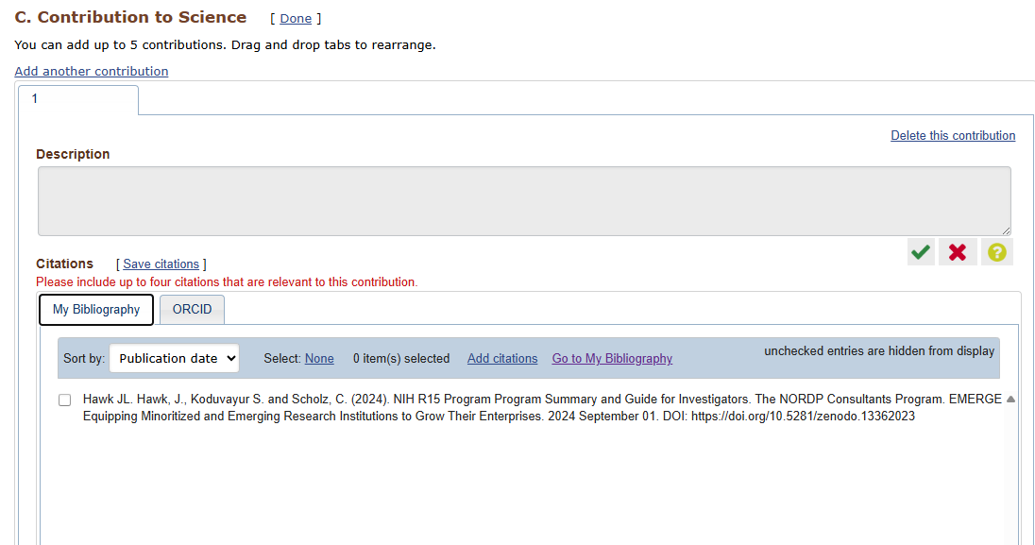
Adding Citations

Slide 24
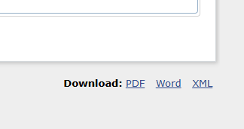
Downloading

