Slide 1
K-Club
Feedback-Driven Aims: A Smarter Approach to Grant Writing
0 5/11/26

Slide 2
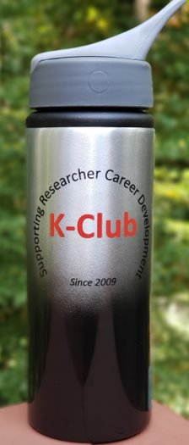



Survey Drawing

Slide 3
Survey Drawing
April Winner: Justin Yoo

Slide 4
K-Club Special:
PhRMA Foundation Translational Medicine Faculty Starter Grant
The PhRMA Foundation seeks research proposals that focus on identifying unmet clinical needs and developing new diagnostic, therapeutic, and computational approaches and technologies to improve patient care.
Applicants (U.S. and non-U.S. citizens) must be full-time, promotion-eligible, research-intensive faculty at a PhD-granting accredited U.S. university by the time of LOI submission.
Applicants are ineligible if their faculty status began before January 1, 2025.
Applicants are ineligible if their last terminal degree was conferred before January 1, 2017.
Applicants should not have other substantial sources of research funding, excluding intramural funding or startup funding from their university. Preference will be given to applicants with startup funding less than $750,000.
  Deadline: May 27, 2026 5 PM
More Information Here
Notes:
Internal catalyst grants?

Slide 5
K-Club Special:
Georgia CTSA Mentoring Community
This 9-month program offers structured one-on-one and group mentoring for postdocs, clinical fellows, and junior faculty, designed to help you build skills, expand your network, and grow as a clinical and translational researcher.
💡 What you’ll gain:
• Career guidance from experienced mentors
• Opportunities to build meaningful professional relationships
• Enhanced clinical & translational research skills
• Greater confidence in your research direction
Questions? Contact Gray Messina
  Deadline: June 1, 2026 5 PM
Apply Here
Notes:
Internal catalyst grants?

Slide 6
K-Club Special: Transforming Ideas into Impact: Convergence Research, Internal Seed Program (SVPR) (FY27)
The Office of the SVPR seeks to spur convergence research and strengthen external proposals that will support the research team’s pursuit to solve vexing research problems with societal impact by providing the resources to formulate teams and ideas, as well as demonstrate success in early transdisciplinary projects that result in new frameworks, methods, and approaches and co-publications.
This seed program has an explicit expectation that awardees will go on to compete for external grants that support convergence research, which may include NIH P- or U- series, NSF centers, NSF convergence accelerator, and other mechanisms from federal and/or private sponsors that can support convergence research teams.
For Phase 1: Planning Awards – A total of up to $10,000 may be requested. For Phase 2: Pilot Awards – A total of up to $120,000 may be requested.
Proposing teams must include at least two Emory faculty members each of whom are from different colleges or schools. Although we expect that successful Phase 2 applicants will describe larger teams.
Regular, continuing full-time faculty of Emory University are eligible to apply for awards.
  Deadline: June 4, 2026 5 PM
More Information Here

Slide 7
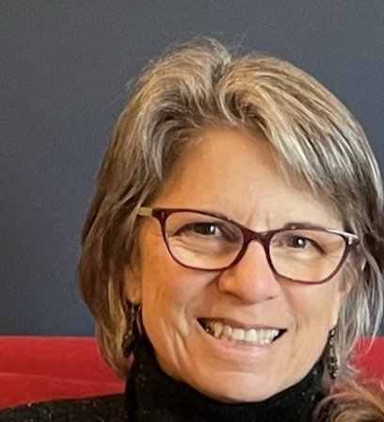
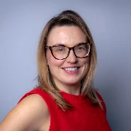
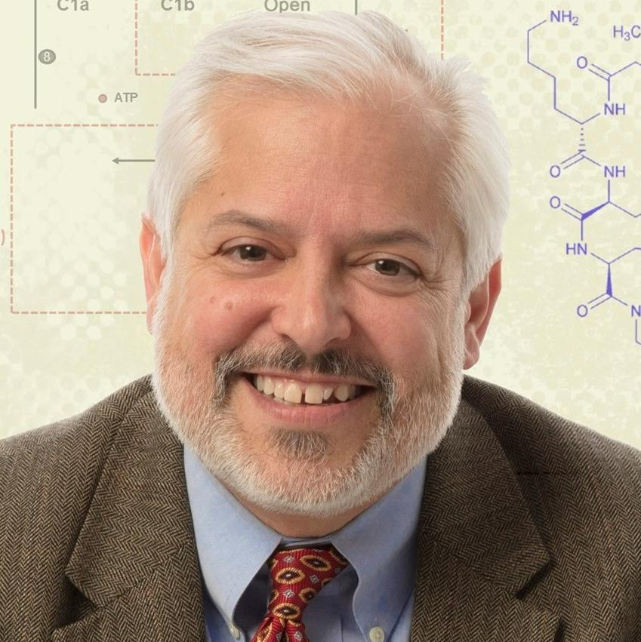
May K-Club: Feedback-Driven Aims: A Smarter Approach to Grant Writing
Janet Gross, PhD
Grant Writing Consultant; Adjunct Assistant Professor, Department of Medicine; Co-Director, Scientific and Grant Writing for Clinical Research; Co-Director, Advanced Grant Writing for Clinical and Translational Research, Emory University
Kathleen Krause, PhD
Assistant Professor, Department of Pediatrics; Department of Psychiatry and Behavioral Services
Emory University SOM
Nael McCarty, PhD
Professor;
Director, Emory + Children’s Cystic Fibrosis Center of Excellence;
Department of Pediatrics
Emory University SOM

Slide 8
Types of Feedback
Peer Feedback
Near-Peer Feedback
Layperson Feedback
Expert Feedback

Slide 9
Giving and Receiving Feedback
Please provide your general experiences—good and/or bad with giving feedback
Please provide your general experiences—good and/or bad with receiving feedback

Slide 10
Why Feedback Matters for Specific Aims
Briefly describe why feedback matters in crafting a solid aims page.
What feedback do you find that you most need or most often give (specific to Specific Aims)?

Slide 11
Types of Feedback for Specific Aims
Do you prefer oral feedback, written feedback, or a mix of the two? Why?
Discuss the advantages that a workshop setting for Specific Aims confers on the writing process.

Slide 12
Specific Aims Best Practices: Intro Paragraph(s)
Did you talk to the program officer? If so, what guidance did they provide, and how confident were they in that advice?
Did you have to re-read a revised RFA or NOFO? If so, what kinds of changes had been made? How obvious were they?

Slide 13
Feedback for Intro Paragraph(s)
What is the best feedback you have either given or received for the introductory material on a Specific Aims page?
What do you wish you had known about the introductory material the first time you wrote Specific Aims?

Slide 14
Specific Aims Best Practices: The Aims
What are your thoughts about how many aims there should be? How does this answer differ by mechanism?
Describe the optimal structure of a Specifc Aim and why you think that is the optimal way to do it. Are there exceptions to this ideal structure?

Slide 15
Specific Aims for K Grants
What are some differences to consider when writing the Aims for a K mechanism than, say, from an R01 or R21?
What are some ways to instill aspects of the Career Development plan into the Aims page without eating too much space?

Slide 16
Panelist Experiences: Final Thoughts
What have we missed in today’s discussion that you think simply must be said?
What fun things are you doing this summer? Let us give you some feedback on it.

Slide 17
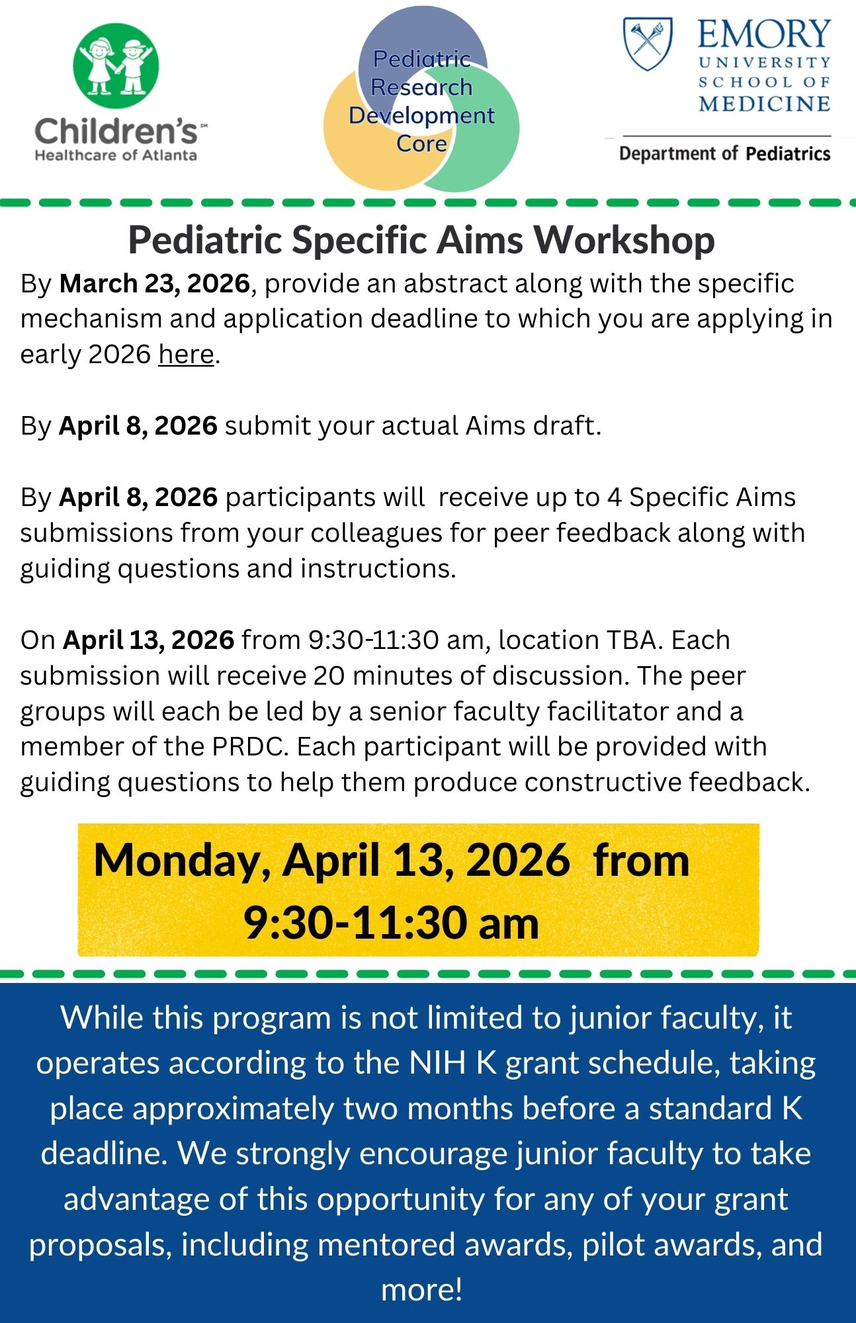
Shameless Promotion and Call for Collaborators
The Pediatric Research Development Core has run 3 Specific Aims Workshops so far.
We have had a lot of people from outside Pediatrics want to participate, but we don’t have the bandwidth to do that…
Unless we collaborate across departments.
Let’s talk! Email Julie Hawk

Slide 18
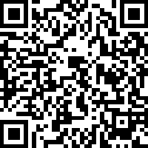
Give us YOUR Feedback
This is the last survey of the academic year, so be sure to tell us what you would like to hear more about next year!

